Slide 1
Prohibited Practices in Cannabis
Enforcement Education Program

Slide 2
Relevant Laws and Rules
RCW 69.50.328
Cannabis producers, processors—No direct or indirect financial interest in licensed cannabis retailers.
Neither a licensed cannabis producer nor a licensed cannabis processor shall have a direct or indirect financial interest in a licensed cannabis retailer.
WAC 314-55-018
Prohibited practices—Money advances—Contracts—Gifts—Rebates, discounts, and exceptions, etc.
No industry member or licensee shall enter into any agreement which causes undue influence over another licensee or industry member. This rule shall not be construed as prohibiting the placing and accepting of orders for the purchase and delivery of cannabis that are made in accordance with usual and common business practice and that are otherwise in compliance with chapter 69.50 RCW and this chapter.
No cannabis producer or processor shall advance, and no cannabis licensee shall receive money or moneys' worth under an agreement written or unwritten or by means of any other business practice or arrangement such as:
Gifts
Discounts
Loans of money
Premiums
Rebates
Free product of any kind except as specified in RCW 69.50.585
Treats or services except as specified in RCW 69.50.585

Slide 3
Prohibited Practices NTCs
 | 2023 | 2024 | Grand Total
(CB) Engaging in conditional sales. | 1 | 2 | 3
(CB) Engaging in nonretail conditional sales, prohibited practices, or both. | 13 | 50 | 63
(CB) Selling or purchasing Cannabis on credit. | 3 | 49 | 52
Grand Total | 17 | 101 | 118

Slide 4
How Do Complaints Come In?
Reports from the Finance Audit team
Complaints from licensees
Licensees checking with Enforcement about proposals from other licensees
Former employees of retail licensees

Slide 5
Examples of Prohibited Activities
Examples of prohibited activities include, but are not limited to:
Producer or processor lending or giving money to a retailer
Gifts beyond nominal value
Extension of credit
Volume discounts
Discount of product to one retailer over another
Licensees creating a second company to give away items or sell items below true market value to a retailer
Producer or processor having or sponsoring events for licensees or employees of a retailer
Incentive programs (swag, prizes, or cash for selling a producer/processor’s items)
Negotiating any discount for customers of a producer/processor’s product (rebates, split discounts, custom products, etc.)
Retailers requiring bulk discounts, rebates, custom products, or services outside of what is allowed in RCW 69.50.369

Slide 6
What is allowed?
Producers and processors can provide some items and services to cannabis retail licensees, but they are limited to items of nominal value, and those items cannot be passed on to retail customers. Producers and processors may also participate in specific retail events, if they follow the parameters outlined in RCW 69.50.585.
Items of nominal value such as branded promotional items (lighters, pencils, apparel, and similar items valued $30 or less singularly or in the aggregate)
Educational participation in “vendor day” type events at retail locations
Listing the locations that carry product on the producer / processor licensee’s website
Note: None of these types of allowed activities can be required by either licensee as a condition of business.

Slide 7
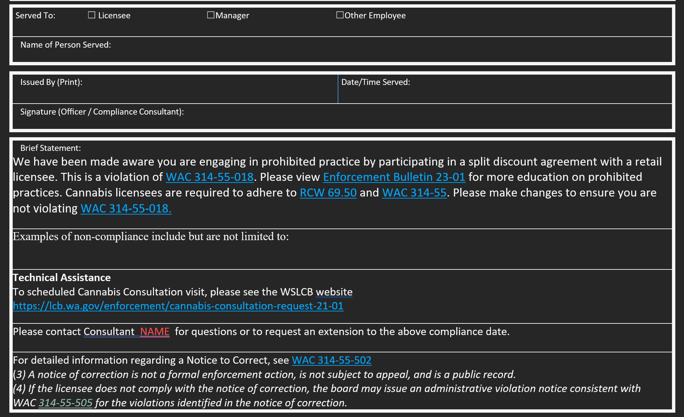
Education
Cannabis_Bulletin_No_23-01_MW_Final.pdf (wa.gov)
Newsletter coming this fall to remind licensees again of the bulletin and the RCWs and WACs
In person education and/or NTC given with in person, on-site, visit (Note: whenever Education staff do on-site visits they try to also do a full annual inspection if one has not been done in over 6 months – 1 year.

Slide 8
External Complaints
Assigned to Education staff
Determine if complaint has enough information to write an NTC or not
Visit licensees in person and discuss the complaint
Ask the licensee if they are engaged in the alleged activity
If they say yes or the original complaint has enough information to prove a violation, education is given through NTC
If they say no and there is not enough information to prove a violation, the same education that is in the NTC is given it is just not done through a formal NTC.

Slide 9
Internal Complaints
Education Manager reviews audit reports
Complaints are assigned to Education staff
Visit licensees in person and discuss the complaint
Education is provided through an NTC
Note: If either scenario continues to have complaints on the same issue it may be escalated to commissioned staff to address

Slide 10
Questions?

