Slide 1
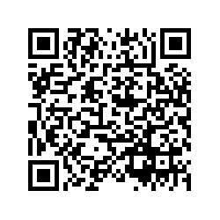
Cannabis Traceability Survey
https://qualtricsxm6pfcscr7l.qualtrics.com/jfe/form/SV_cZOxyqNkgZn09mu

