Slide 1
Cannabis Social Equity Program Update
September 13, 2023
Aaron Washington, Social Equity Program Manager
Linda Thompson, Cannabis Licensing Manager

Slide 2
Third-Party Contractor Review Complete
The Liquor and Cannabis Board (LCB) used a third-party contractor as recommended by the Social Equity in Cannabis Task Force to review and prioritize all social equity applications.
Ponder Diversity’s role was to review the application and supporting documentation to determine which applicants met the criteria for the program.
Ponder Diversity has completed their review of all social equity applications.
The LCB anticipates applicants will begin receiving notifications on their application status within the next two weeks.

Slide 3
Next Steps
Highest Scoring Application by County
46 Licenses Available & Title Certificate Holders
LCB Retail Application Process
Applications returned from Ponder Diversity Group
Qualified Title Certificate Holder
Preliminary Letter of Approval
Application Score Tied by County
Double Blind Lottery
Application Withdrawn
Disqualified Application
Application Withdrawn

Slide 4
Retail Cannabis Licensing Process
Successful applicants will be invited to a live webinar to introduce the team, provide an overview of next steps, share the licensing application process, and conduct a survey of readiness.
A Social Equity Case Manager will be assisting with:
Technical Assistance
Resources
A Senior Licensing Specialist will be assisting to ensure applicants meet licensing requirements:
Including but not limited to, verifying location, financing, completing an operating plan, and criminal history forms.

Slide 5
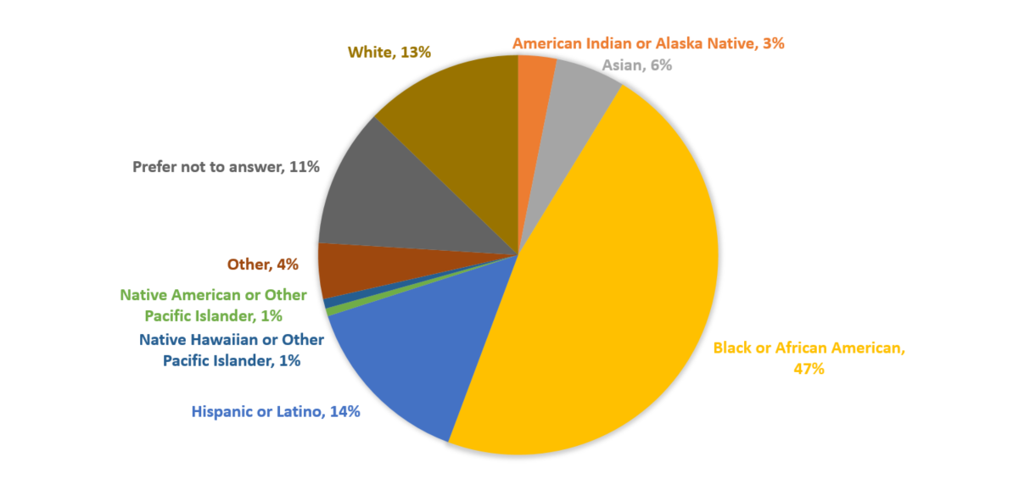
Application Demographics

Slide 6
Questions?
Please stay tuned to the LCB Social Equity Website for updated information.
Questions can be directed to the licensingsocialequity@lcb.wa.gov.

