Slide 1
Welcome Traceability Software Integrators

Slide 2
Current Status
Pushing weekly releases to both WA Stage and WA Test environments
Highest priority – core functionality & API impacts
QA in WA Stage – MJF, then LCB
Working bug fixes and QA findings, push hotfixes to WA Stage & WA Test
Working performance issue – identified cause and have path to resolution
Working issues identified by integrators
Critical issues such as performance issue underway
Non-critical issues such as ideas for improving calls, cosmetic items captured but deferred until after go live

Slide 3
API Documentation updated - ongoing effort to improve https://watest.leafdatazone.com/api_docs/test Draft User Manual Addendum C – relates UI with API Draft User Manual Addendum A – step by step in UI Release notes – changing process to add info on where API impacts are Q & A list – compiling questions and capturing answers to share with all integrators
Documentation

Slide 4
Licensee Support
MJ Freeway
888-420-5813
wasupport@leafdatasystems.com
Support Topics
Licensee User Interface
General System Support
System access, workflow and usability
Assistance with manifests and transfers
Reporting
Integration Support – APIsupport@leafdatasystems.com
October support hours: 8 AM to 6 PM PT M-F; 10 AM – 4 PM S-S
After cutover: 6 AM to 6 PM PT seven days a week

Slide 5
Software Validation
Integrators will develop against their WA Leaf Data Systems test account. This will involve both integration and validation work
Examples of calls that need to be executed successfully for validation:
Batch
Disposal
Inventory
Inventory Adjustment
Inventory Transfer
Lab result (for Testing Lab licensees only)
Plant
Sale
Tax
User
Harvest batch

Slide 6
Software Validation
MJ Freeway will pull logs after the integrator reports that the required API calls have been completed
MJ Freeway will evaluate required calls for successful completion:
Calls contain required data
Review for excessive number of calls
Determine if any calls returned errors
If calls successful then integrator will be added to validated vendor list – vendor will be posted to approved vendor lists on MJ Freeway and WSLCB websites and the vendor will be notified

Slide 7
Release Schedule
Release | Date | Main Content Areas
1.15 | Sep 9-10 | Plants and Harvested Materials; Intermediate and End Products; Interfaces (initial); Data Migration; Administration
1.16 | Sep 16-17 | Plants and Harvested Materials II; Intermediate and End Products II; Transporter – license types;
1.17 | Sep 23-24 | Samples ; Manifests; Labs – additional functionality
1.18 | Sep 30 – Oct 1 | Licensee User Interface (UI); SAW integration
1.19 | Oct 7-8 | Interfaces (remaining) [WSP ACCESS; Tax & Fee; Licensing]
1.20 | Oct 14-15 | Non-functional requirements (Security; OCIO compliance requirements)

Slide 8
Data Conversion Status
Receiving weekly copies of database dump from the current MJ Traceability System
LCB team processes data and pushes to MJF team
MJF team loads data into Leaf Data Systems environment
Repeat process and find ways to streamline
Perform validations on data to verify conversion successful

Slide 9
Data Conversion
Primary Plan
Use a dump of the current traceability database to convert data for all licensees before implementation.
Backup Plan
If LCB is not able to execute conversion for any reason, Licensees will need to create their data after cutover using:
State Traceability Web Site
CSV File Interface
Commercial Software

Slide 10
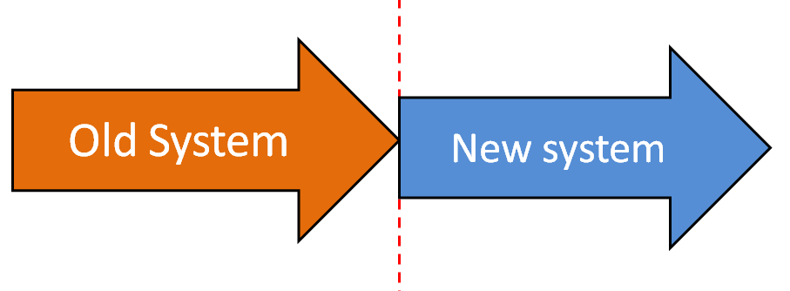
Cutover Plan
The transition period from current traceability to Leaf Data Systems is currently scheduled for 58 hours:
40 hours of processing
18 hours of contingency
We are working to reduce this time frame
Licensee product transfers will not be permitted during the transition period
Licensees MUST update Leaf Data Systems with all activities that occurred after current traceability system is shut down
We’ve asked for Advisory Committee input as to when to begin the transition

Slide 11
Planning Ahead
Validation
Targeting 15 Oct release for code freeze
Prioritizing API impacting issues
Engaging your licensees
Create a cutover plan with your licensees that addresses downtime, data conversion & transactions that have to be deferred (e.g. transfers)
Address creating a record of transactions during system downtime (or a back-up csv file that can be uploaded after go-live by)
Communicate your validation status regularly
Check the Traceability Site Integrator’s page for updates

Slide 12
Questions?

