Slide 1
Traceability System Update
Ability to “undo” a New Plant, Cure and Harvest
July 29, 2016

Slide 2
Overview of New Functionality
New functionality will allow producers to:
Undo new plant creation.
Undo cure and harvest.
All examples are created using the WSLCB Traceability System Interface located at wslcb.mjtraceability.com. If you use a third party software system you will need to contact your vendor for system specific instructions

Slide 3
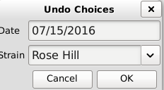
Undo New Plant Creation
From the Administration tab, select Cultivation > Undo > New Plant.
Enter the date the plant was created and the strain.

Slide 4
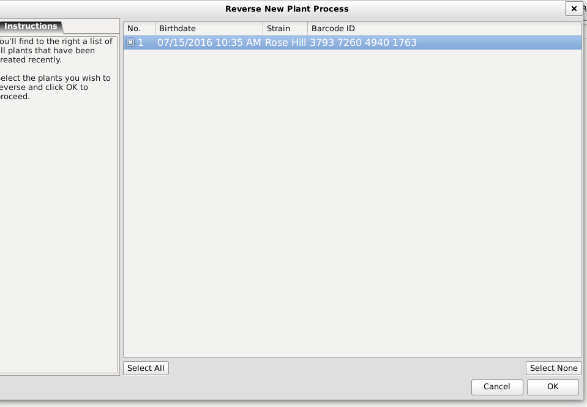
Undo New Plant Creation
Select the plant you wish to reverse and click “OK”.

Slide 5
Undo New Plant Creation
The plant will disappear from the Cultivation room, and the quantity of the Source ID that the new plant was created from will be restored to its original number.
For example, if there were initially two Rose Hill seeds and one of them was used as the Source ID to create the new plant, there would have been one seed left. After reversing the creation of the new plant, there would again be two Rose Hill seeds available to use as a Source ID.

Slide 6
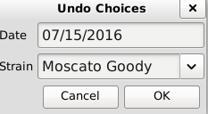
Undo Cure and Harvest
From the Administration tab, select Cultivation > Undo > Cure Plant.
Enter the date and strain.

Slide 7
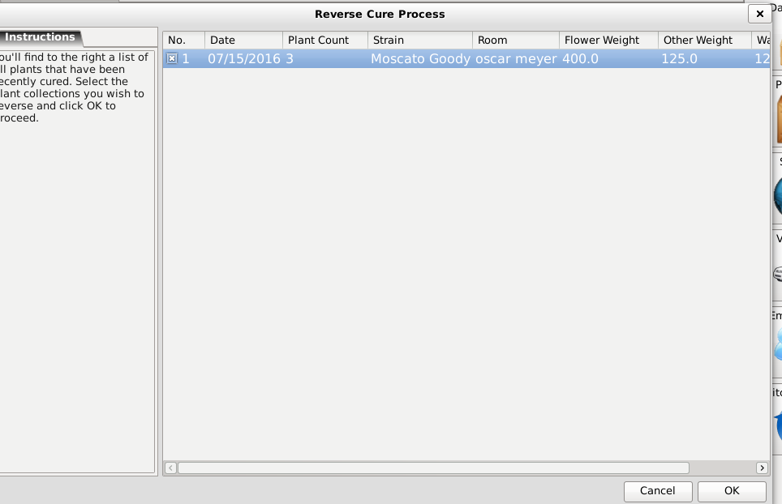
Undo Cure and Harvest
Select the cured plant you wish to reverse and click “OK”.

Slide 8
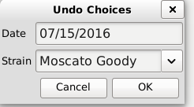
Undo Cure and Harvest
Next, undo the harvest by selecting the Administration tab > Cultivation > Undo > Harvest Plant.
Enter the date and strain.

Slide 9
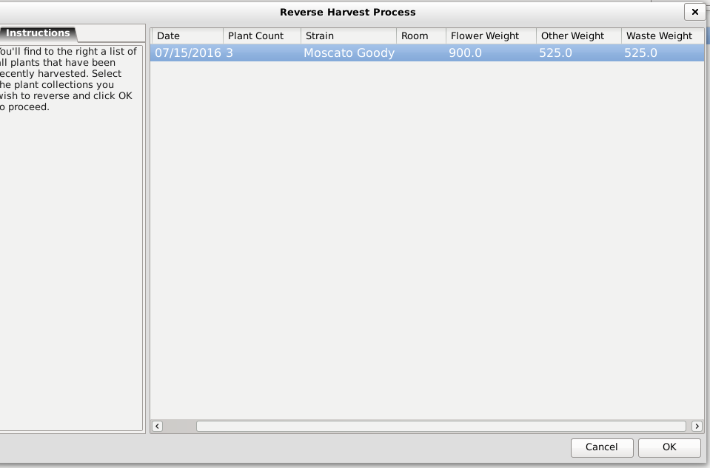
Undo Cure and Harvest
Select the harvested plant you wish to reverse and click “OK”.

Slide 10
Undo Cure and Harvest
All traces of Flower, Other Material or Waste from the cured and harvested plant will disappear from Inventory and Yield Data Correction.
The plant will be placed back into the Cultivation room.

Slide 11
Thank you!

