Slide 1
Traceability System Update
Destroying products at retail locations
June 24, 2016

Slide 2
Overview of New Functionality
New Functionality will allow retailers to:
Destroy products at their licensed retail location by rendering the marijuana product into waste as required in WAC 314-55-097 - Marijuana waste disposal.
All examples are created using the WSLCB Traceability System Interface located at wslcb.mjtraceability.com. If you use a third party software system you will need to contact your vendor for system specific instructions

Slide 3
Statutory Approval
RCW 69.50.357 was changed in the 2016 Legislative Session by HB 2521 to allow for marijuana products to be open at retail locations for the purposes of disposal as authorized by the WSLCB.

Slide 4
Destroying Products at Retail
To destroy products at retail locations in the Traceability system, select the line item you would like to set for destruction.

Slide 5
Destroying Products at Retail
After the line item is highlighted select the Destroy button located at the bottom of the Inventory tab screen.

Slide 6
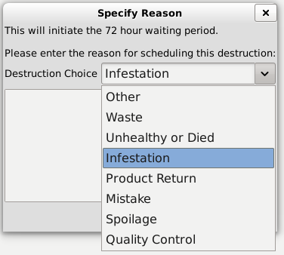
Destroying Products at Retail
A window will appear requesting a reason for destruction and indicating the mandatory 72hr quarantine period.
Select a reason for the destruction from the drop down menu
If selecting “Other” you must add a description in the text field below

Slide 7
Destroying Products at Retail
The system will verify that the highlighted item was successfully scheduled for destruction.
At which time the mandatory 72 hour quarantine will be triggered and identified under the status column next to the line item.
The hours will count down until the 72 hour period has ended. The status will then change to “ready for destruction.”

Slide 8
Destroying Products at Retail
After you have rendered the marijuana product into waste as prescribed in WAC 314-55-097 - Marijuana waste disposal – you will then highlight the line item, and select the Destroy button again to complete the destruction and remove the product from the system.
When you select “Destroy”, the system will ask you if you would like to continue:
After you select “Yes” the system will confirm the product has been destroyed and it will be removed from your inventory.

Slide 9
Thank You!

