Slide 1
Traceability System Update
Ability for shipping vendors to receive product back in their inventory from multistop manifests
June 24, 2016

Slide 2
Overview of Functionality
New Functionality Allows Shippers to:
  Bring inventory items, including vendor samples, back from an outbound shipment that was never or partially accepted, even if the items are on a multi-stop manifest.
All examples are created using the WSLCB Traceability System Interface located at wslcb.mjtraceability.com. If you use a third party software system you will need to contact your vendor for system specific instructions

Slide 3
Previous Multistop Manifests
Licensees could void manifests, stops, and line items before transferring outbound.
Licensees were unable to void a stop on a multistop manifest if at least one stop accepted items.
Licensees could void transfers on a multistop manifests as long as no stops received product.

Slide 4
Issues with Previous
Manifest Functionality
Shippers were unable to bring back inventory items and vendors samples on a multistop manifest if one stop accepted items.
The only option was for the receiving vendors to reject the shipment in order for the shipping vendor to receive it back in their inventory.

Slide 5
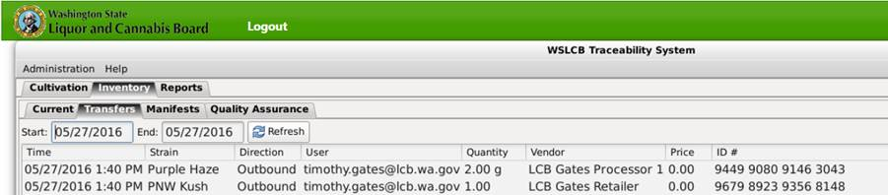
How to receive product back:
For Example:
  I create a multistop manifest with vendor samples going to two different locations that I have transferred outbound as shown by my Transfers tab:

Slide 6
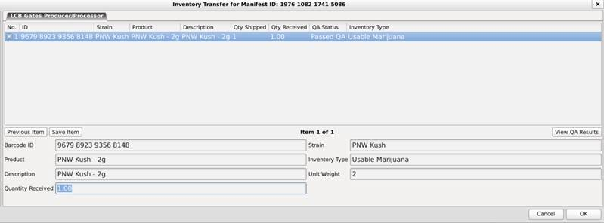
How to receive product back:
Example Continued:
  One of the stops accepts the vendor sample as shown by the Inbound Transfers screen:

Slide 7
How to receive product back:
Example Continued:
  But the second stop did not accept the product. Perhaps they were unexpectedly closed for business that day, or they changed their minds about accepting the vendor sample, but do not reject it in the system.
  How do you bring the product back?

Slide 8
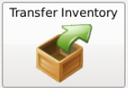
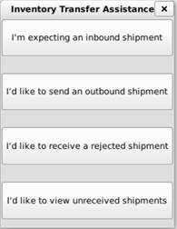
How to receive product back:
Example Continued:
  The new system enhancement will allow a shipper to bring the product back from the second stop.
  1. Select “Transfer Inventory” button:
  2. Then select the “I’d like to receive a rejected shipment” button:

Slide 9
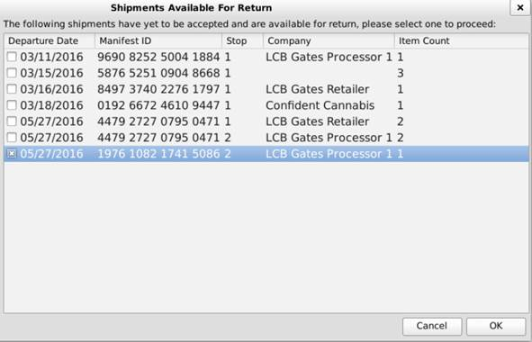
How to receive product back:
Example Continued:
  Then check the box located next to the transfer from the processor who never accepted the product, and select OK:

Slide 10
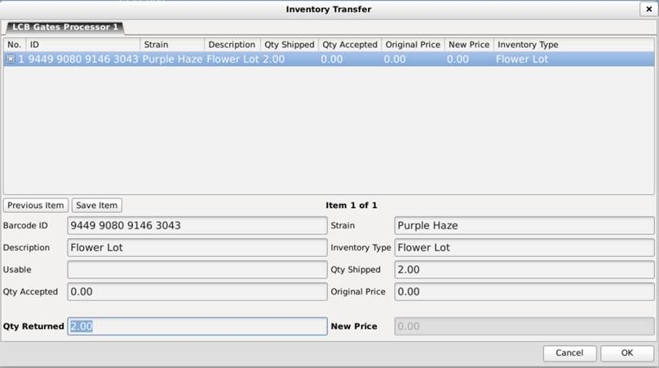
How to receive product back:
Example Continued:
  The Inventory Transfer screen will appear. The quantity is already entered. Simply select the Save Item button, and then select the OK button to confirm receipt of the inventory product back:

Slide 11

How to receive product back:
Example Continued:
  The system will then ask if you are sure you would like to proceed, after you select Yes, the system will then confirm the Transfer was successful:
  And the product will be brought back to your Inventory.

Slide 12
Thank you!

