Slide 1
Traceability System Update
Medical
June 23, 2016

Slide 2
Overview of New Functionality
New functionality will allow producers to:
  Test for pesticides and heavy metals at the harvest level.
  Create ‘Flower Lot’ designated as medical compliant, per WAC 246-70.
New functionality will allow retailers to:
  Sell and/or donate products to qualifying patients and designated providers.
All examples are created using the WSLCB Traceability System Interface located at wslcb.mjtraceability.com. If you use a third party software system you will need to contact your vendor for system-specific instructions.

Slide 3
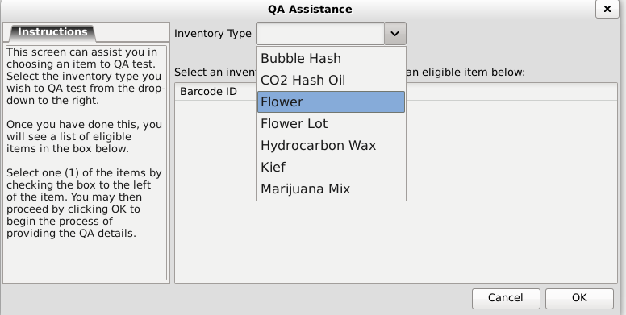
Pesticide Testing at Harvest
‘Flower’ material may now be tested for pesticides and heavy metals prior being converted into a ‘Flower Lot’.

Slide 4
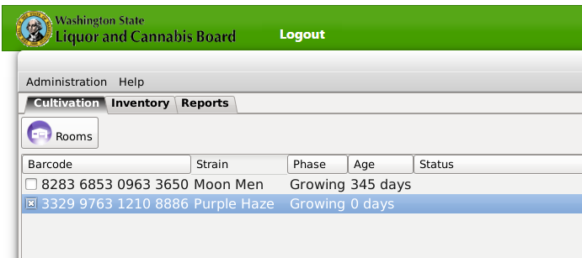
Pesticide Testing at Harvest
As an example, consider this Purple Haze plant, ID number 3329976312108886.

Slide 5
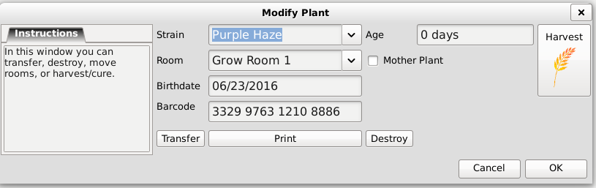
Pesticide Testing at Harvest
3329976312108886 is harvested.

Slide 6
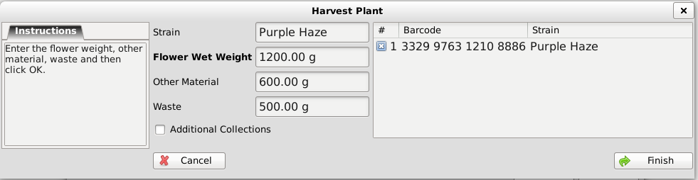
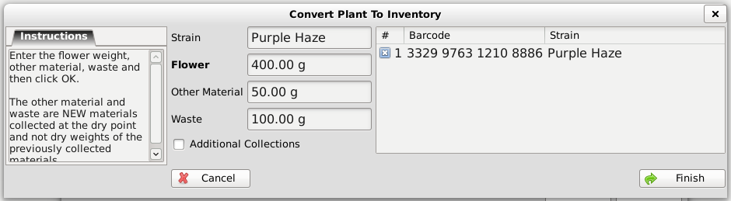
Pesticide Testing at Harvest
Wet weights and dry weights for 3329976312108886 are entered.
Wet
Dry

Slide 7
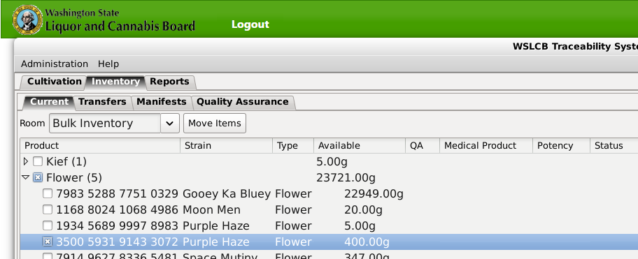
Pesticide Testing at Harvest
3329976312108886 is now in inventory as ‘Flower’ and its ID number is 3500593191433072.

Slide 8
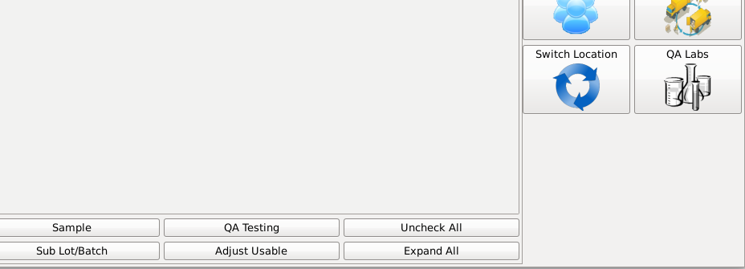
Pesticide Testing at Harvest
With 3500593191433072 selected, click the ‘QA Testing’ button near the bottom right.

Slide 9
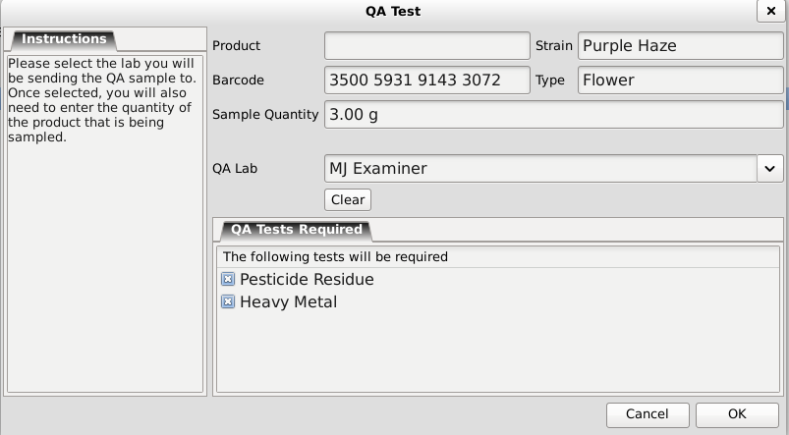
Pesticide Testing at Harvest
Populate the ‘QA Test’ window.

Slide 10

Pesticide Testing at Harvest
In this example, the sample quantity is 1g.

Slide 11

Pesticide Testing at Harvest
A 1g sample does not meet the minimum requirement per WAC 246-70-050.
At least 3 grams are required.

Slide 12
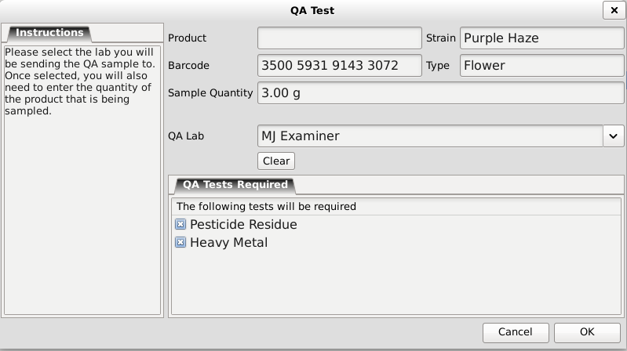
Pesticide Testing at Harvest
Once the minimum sample size has been entered, the sample can be created.

Slide 13
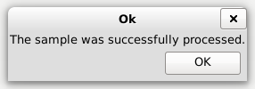
Pesticide Testing at Harvest
Confirmation the sample was created is given.

Slide 14
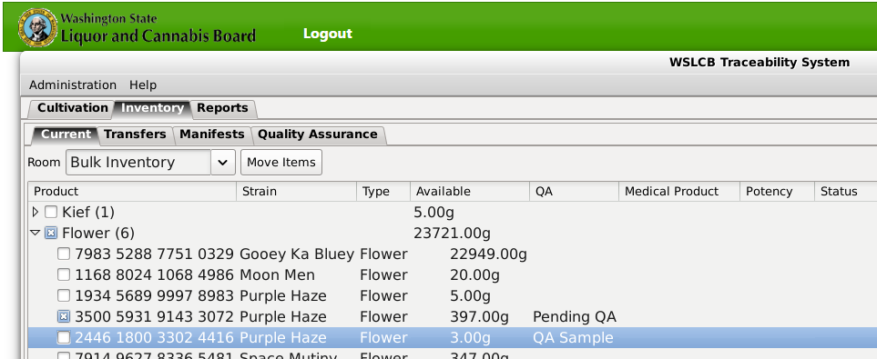
Pesticide Testing at Harvest
Inventory now displays 3500593191433072 as ‘Pending QA’ and 2446180033024416 as the ‘QA Sample’.

Slide 15
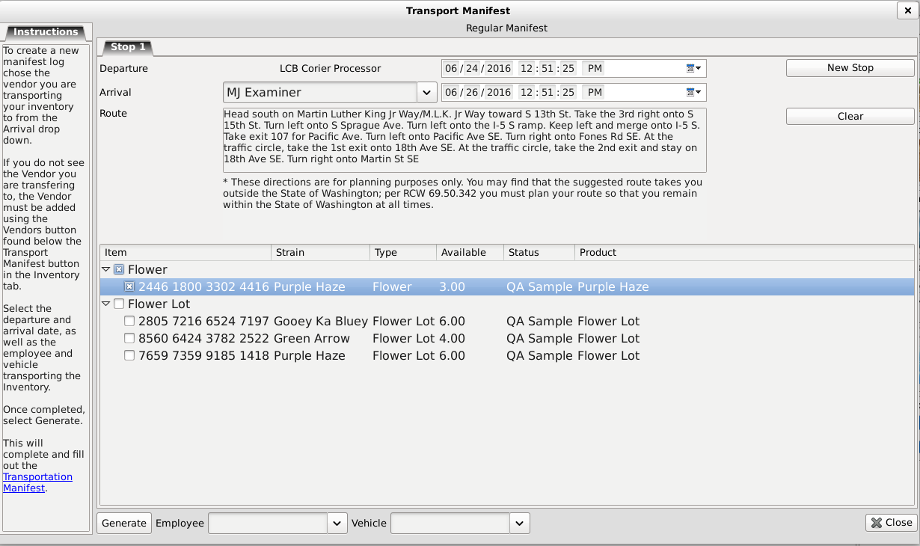
Pesticide Testing at Harvest
The manifest generation process remains the same.

Slide 16
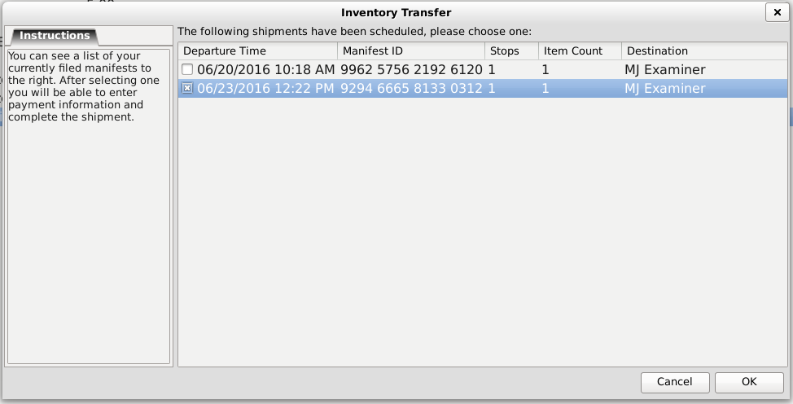
Pesticide Testing at Harvest
The inventory transfer process remains the same.

Slide 17
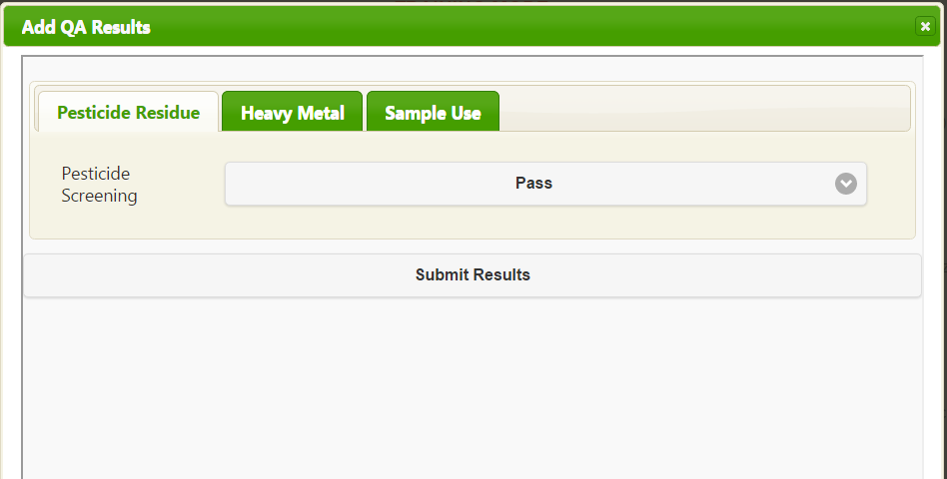
Pesticide Testing at Harvest
The certified lab may only enter Pass/Fail results.

Slide 18
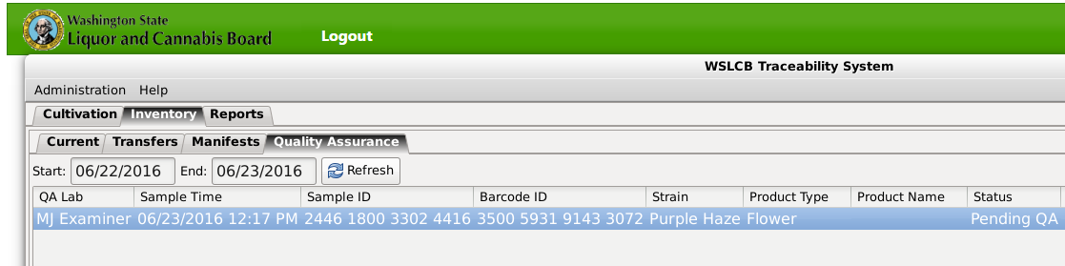
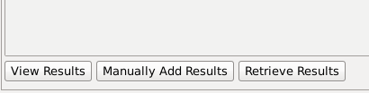
Pesticide Testing at Harvest
The process to retrieve QA results remains the same.
  Under the ‘Inventory’ tab, and the ‘Quality Assurance’ sub-tab, set the date range.
  To retrieve the results, click the ‘Retrieve Results’ button near the bottom left.

Slide 19
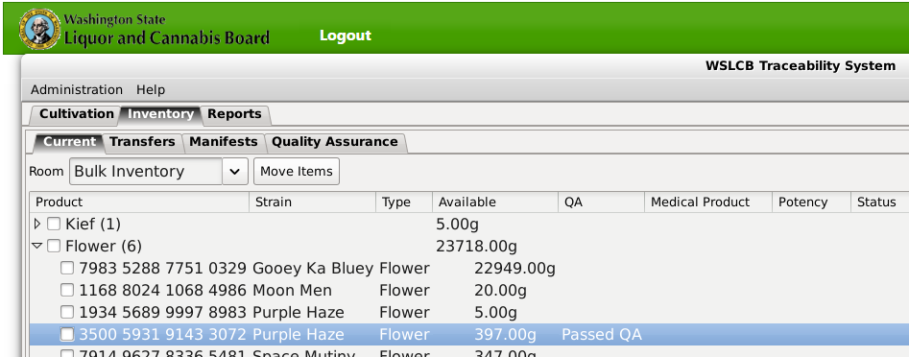
Pesticide Testing at Harvest
In Inventory, 3500593191433072 now shows as ‘Passed QA’.

Slide 20
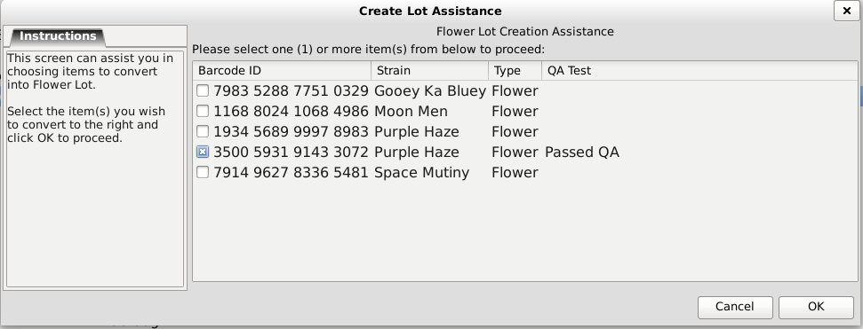
Pesticide Testing at Harvest
When creating a ‘Flower Lot’ using 3500593191433072, the item is designated as ‘Passed QA’.

Slide 21
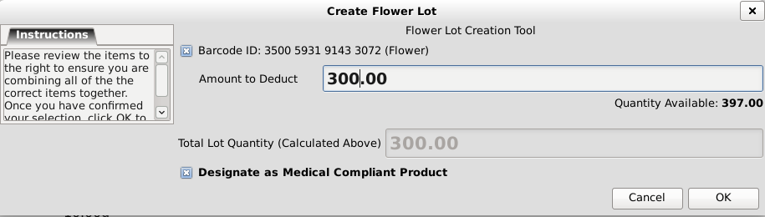
Pesticide Testing at Harvest
Since 3500593191433072 passed QA, it can be designated as a ‘Medical Compliant Product’ when it is made into a flower lot.

Slide 22
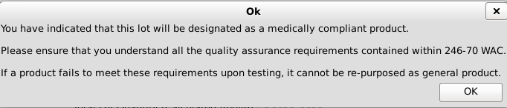
Pesticide Testing at Harvest
After clicking ‘Ok’, a confirmation box appears, which:
  Confirms your action
  Reminds of WAC 246-70
  Warns of re-purposing

Slide 23
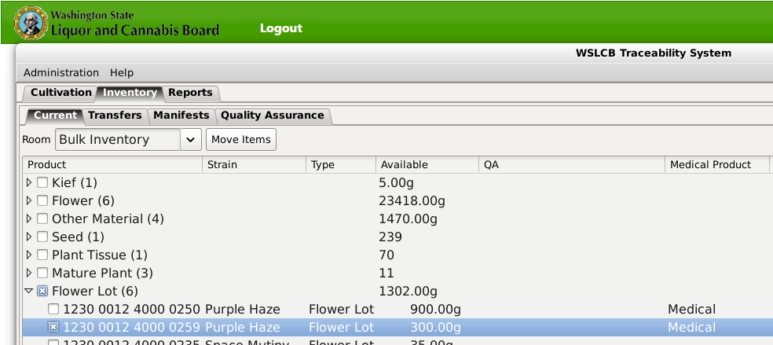
Pesticide Testing at Harvest
The Flower Lot appears with its new ID number, 123000124000259, and the designation ‘Medical’ on the right.

Slide 24
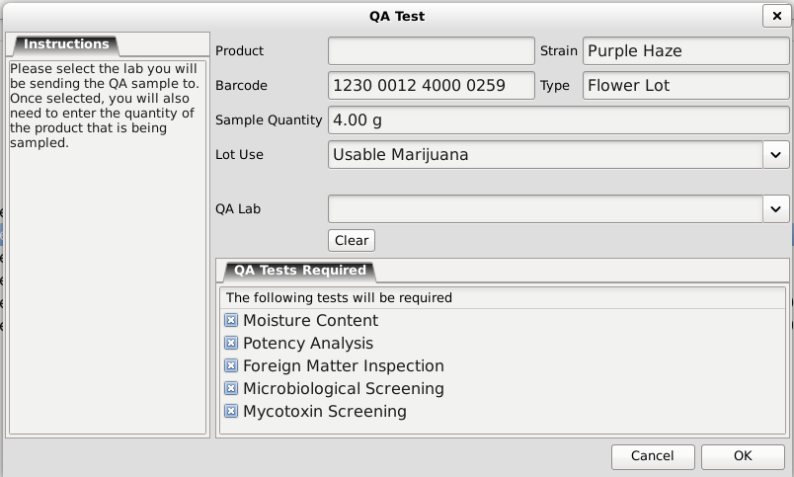
Pesticide Testing at Harvest
If the ‘Flower’ material has already passed pesticide and heavy metal testing, it will not be required again when the ‘Flower Lot’ is tested.

Slide 25
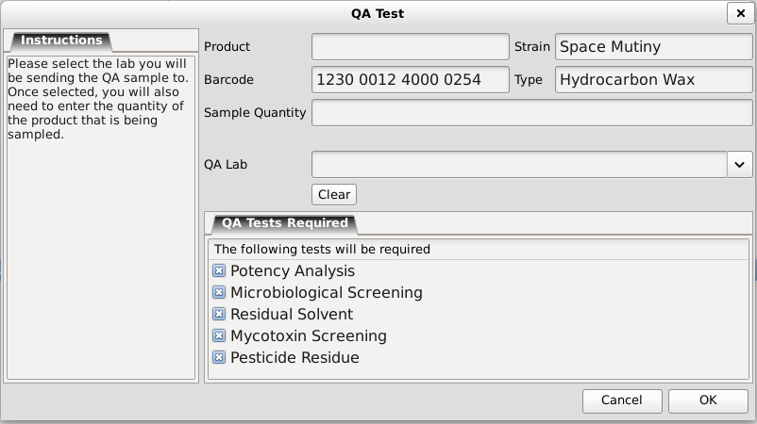
Pesticide Testing at Harvest
Note: Pesticide testing is required at the intermediate product level for extracts.

Slide 26
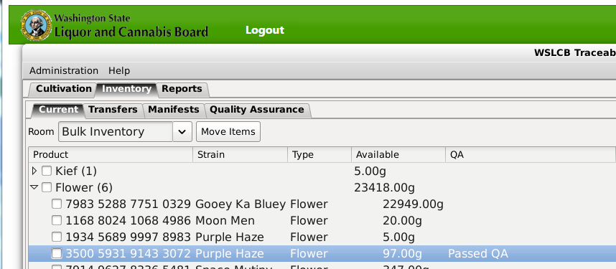
Pesticide Testing at Harvest
The pesticide and heavy metal test results from the ‘Flower’ material 3500593191433072, will also apply to all subsequent ‘Flower Lots’ created from it, though subsequent lots will still need to complete all other required QA tests.

Slide 27
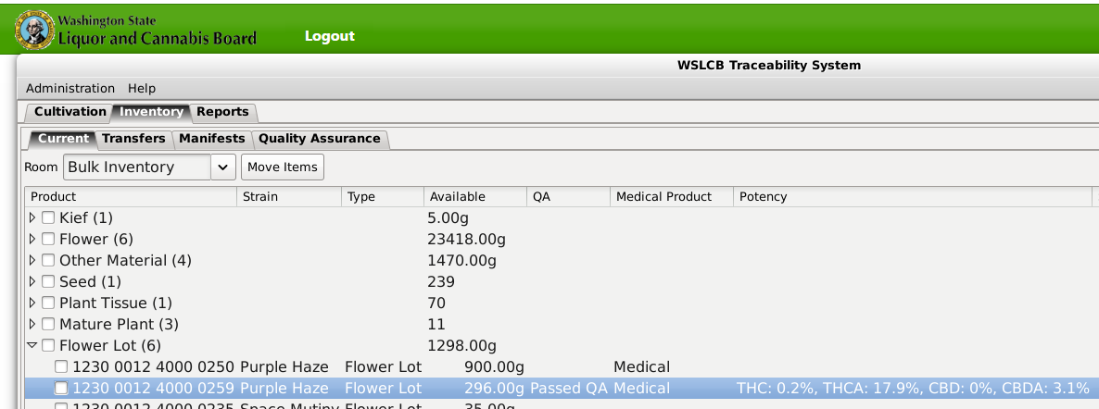
Potency Display
A new feature of the traceability system will display QA potency results in the column next to the inventory item.

Slide 28
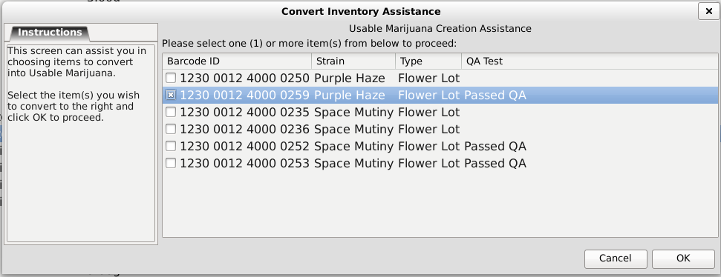
Selling Compliant Products
Flower Lot 123000124000259 is converted into Usable MJ.

Slide 29
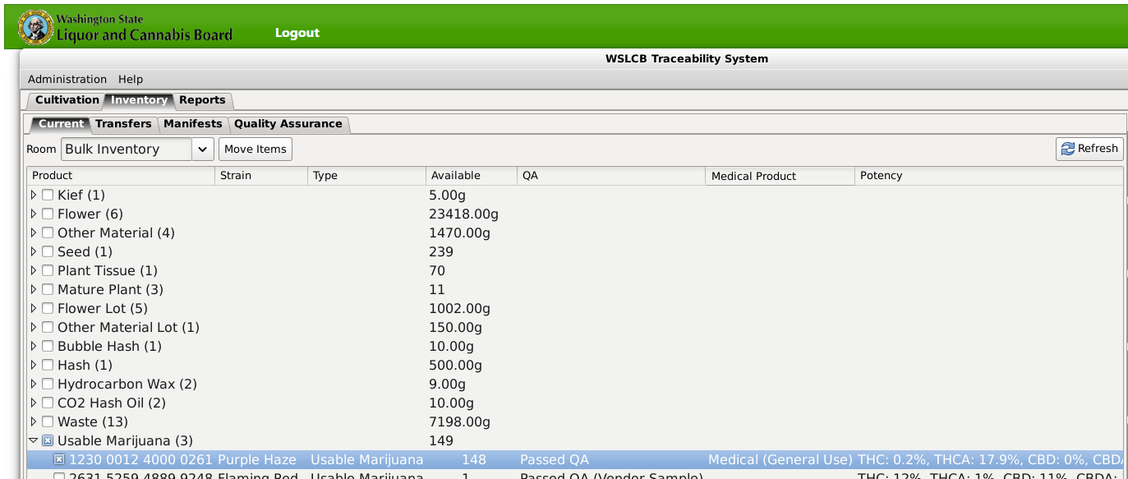
Selling Compliant Products
It is now in the system as 1230001240000261.

Slide 30
Selling Compliant Products
The manifest creation and transfer processes remain the same for Processors selling medical compliant products to Retailers.
The inbound transfer process remains the same for Retailers accepting medical compliant products from Processors.

Slide 31
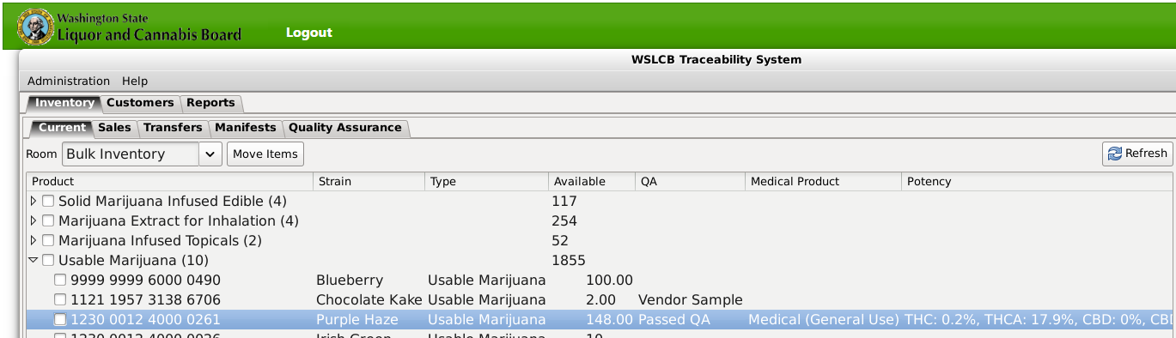
Selling Compliant Products
1230001240000261 displays in Retailer inventory as a medical product.

Slide 32
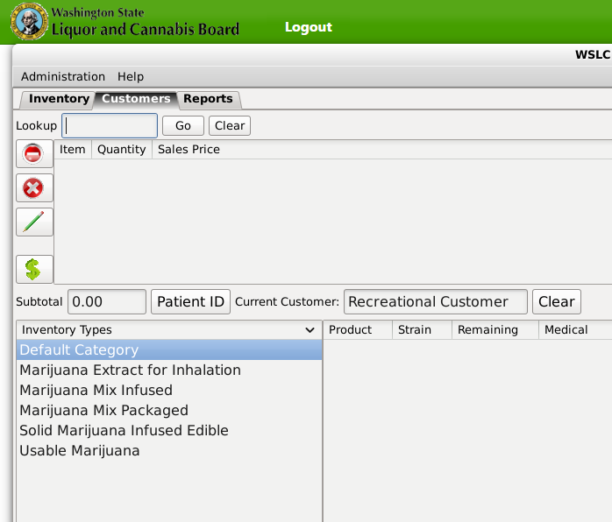
Selling Compliant Products
Under the ‘Customers’ tab, new patient ID functions have been added to the center bar.

Slide 33
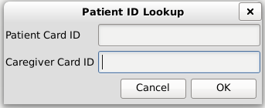
Selling Compliant Products
Clicking the ‘Patient ID’ button will allow retailers to input the 16-digit numbers on Patient ID cards and Caregiver ID cards.

Slide 34
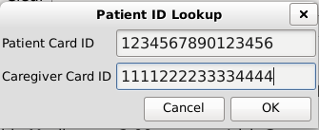
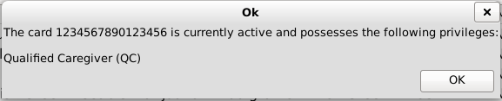
Selling Compliant Products
Entering the numbers will bring up a confirmation box, displaying the Patient Card ID number, and a statement that card is currently active and possesses the Qualified Caregiver privilege.

Slide 35
Selling Compliant Products
Click the ‘Clear’ button on the right to return the ‘Current Customer’ field to its default, ‘Recreational Customer’.

Slide 36
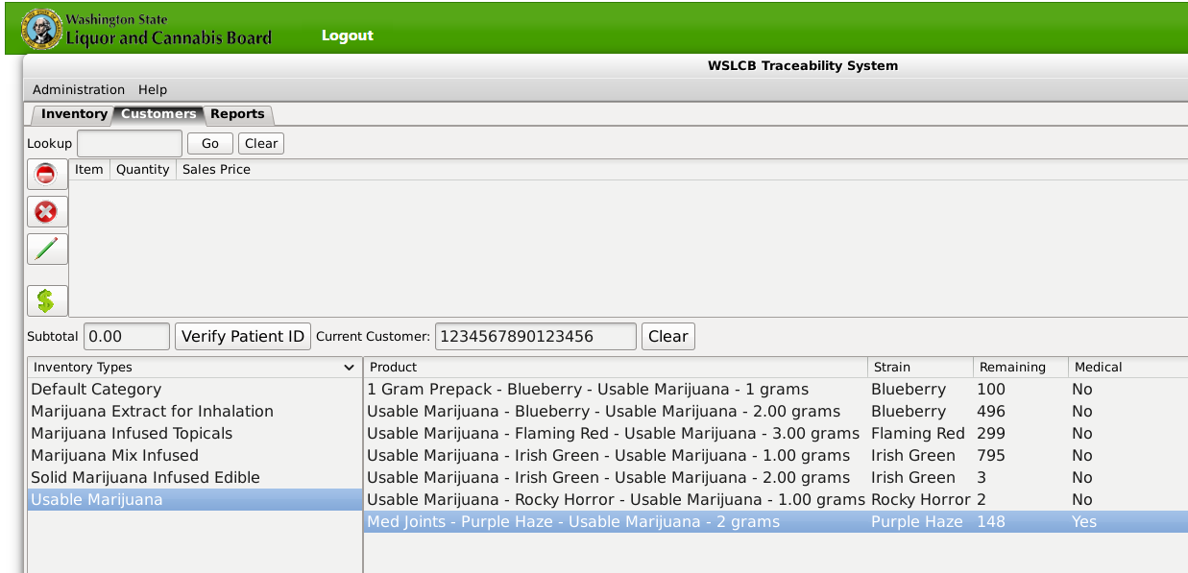
Selling Compliant Products
1230001240000261 displays as usable marijuana under the ‘Customers’ tab, with the medical designation set to ‘Yes’.

Slide 37
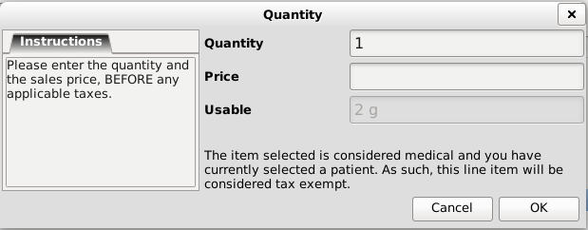
Selling Compliant Products
With a qualifying patient ID number entered, the ‘Quantity’ box indicates this product will be sales tax exempt.

Slide 38
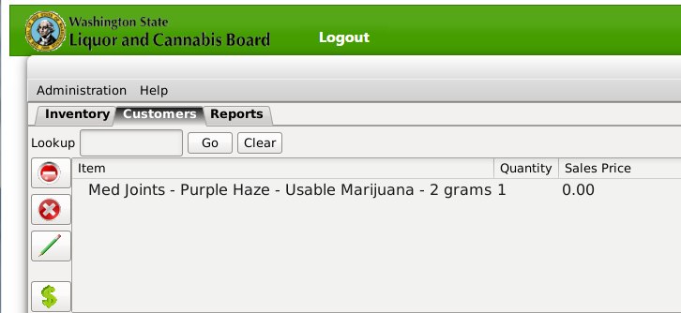
Selling Compliant Products
Per WAC 246-70, All sales to qualifying patients are sales tax exempt. Retailers may sell products to qualifying patients at zero cost.

Slide 39
Thank you!

