Slide 1
Traceability System Update
New education budtender sample allowances from processors to retailers
June 24, 2016

Slide 2
Overview of Functionality
New Functionality Allows Processors to:
  Provide free education samples to retailers for budtender employees to sample for education purposes as prescribed in WAC 314-55-096.
  All education samples are limited to a total of ten units per budtender employee per month, with a maximum of one hundred units per retail location per calendar month.
All examples are created using the WSLCB Traceability System Interface located at wslcb.mjtraceability.com. If you use a third party software system you will need to contact your vendor for system specific instructions

Slide 3
Education Samples
To create an education sample highlight the product you would like to deduct a sample from, then select the “Sample” button located at the bottom of the Inventory tab. This is the same button you would use to create Vendor Samples and Self-Samples.

Slide 4
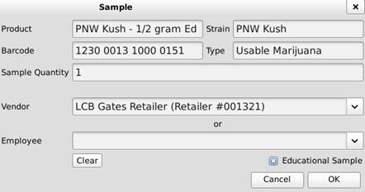
Education Samples
Enter the Sample Quantity
Select the receiving retail vendor
Check the “Education Sample” box
Then select “OK” to proceed

Slide 5
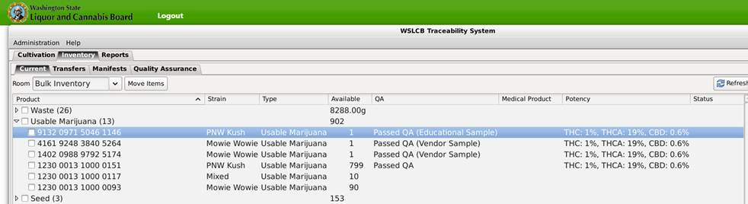
Education Samples
After the education sample is deducted the system identifies as an education sample under the QA Status column in the Inventory tab:

Slide 6
Education Samples
Now the Education Sample is treated exactly like Vendor Samples.
  Manifest the sample to the retailer
  The retailer receives the sample in the system
  The retailer uses the “Sample” button to distribute samples to their budtenders:
    Select the Vendor Sample you want to disperse
    Click “Sample”
    Enter number of samples being removed from inventory
    Click “OK”

Slide 7
Thank you!

