Slide 1
Traceability System Update
Medical Cooperative Traceability Reporting
June 24, 2016

Slide 2
Overview of Functionality
New Functionality Allows Medical Cooperatives to:
  Submit monthly traceability reporting requirements to the WSLCB for nine required reporting fields
  Amend previous reports
  View previous reports
  Appear as a vendor for licensed marijuana producers to wholesale transfer marijuana plants and clones
All examples are created using the WSLCB Traceability System Interface located at wslcb.mjtraceability.com. If you use a third party software system you will need to contact your vendor for system specific instructions

Slide 3
Overview of Functionality
The nine (9) required reporting fields are:
  Number of plants harvested
  Total yield from harvest
  Grams of extract created
  Grams of extract used for edibles, topical, etc.
  Total grams of Usable Marijuana dispensed to members
  Total grams of extract dispensed to members
  Number of plants remaining at coop
  Grams of extract remaining at coop
  Grams of Usable Marijuana remaining at coop

Slide 4
WSLCB Traceability System Access and Overview
Marijuana Cooperatives will be granted access to the WSLCB Traceability system once registered
An email granting access to the system will be provided after registration
Marijuana Cooperatives can access their accounts for reporting at wslcb.mjtraceability.com
Members will use the “Co-op Login” button to access their accounts

Slide 5
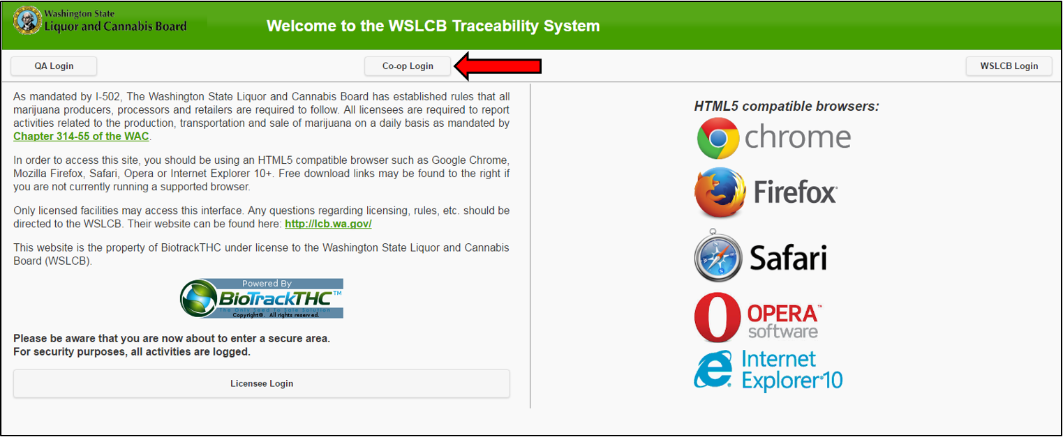
WSLCB Traceability System Access and Overview

Slide 6
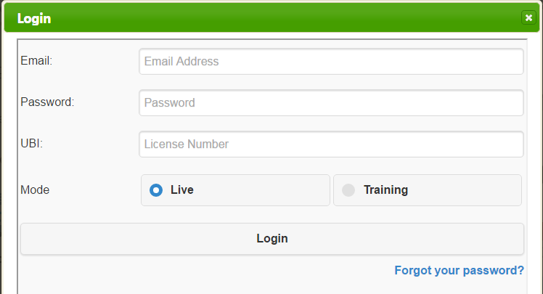
After selecting the “Co-op Login” button the system will ask for the cooperative’s login credentials. The three login credentials are:
  Email – registered with WSLCB
  Password – created by Marijuana Cooperative after registration
  UBI – created by WSLCB for registered Marijuana Cooperative

Slide 7
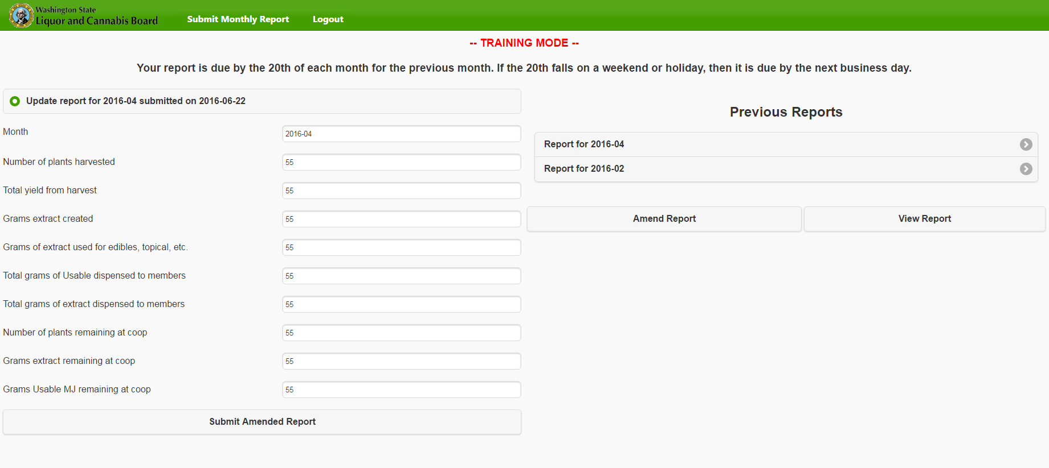
Cooperative Reporting Screen:

Slide 8

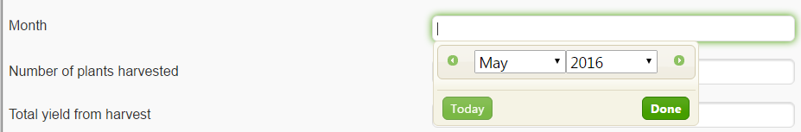
Cooperative Reporting Instructions
To submit a new monthly report:
  Select “Submit a new report” button:
  Select the month of the reporting:

Slide 9
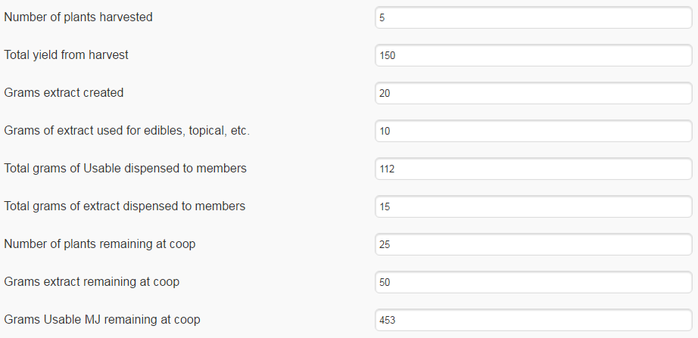
Cooperative Reporting Instructions
Enter the data for the nine reporting fields:

Slide 10

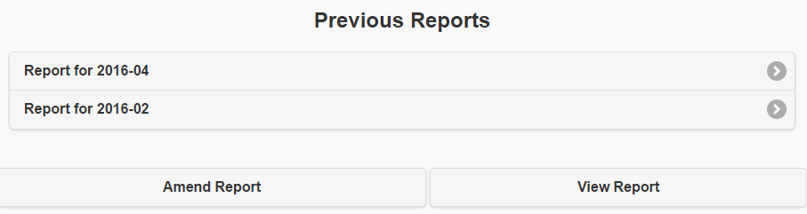
Cooperative Reporting Instructions
Select “Submit New Report,” and you will have completed your required monthly reporting.
To “view” or “amend” previous reports, select the “Amend Report” or “View Report” buttons.

Slide 11
Thank you!

