Slide 1
Cannabis Product, Packaging & Labeling Training Presented by: Susan Harrell
Notes:
Welcome to the cannabis product, packaging and labeling training. At this time, infused edibles are the only cannabis product that requires formal review and approval by the LCB.

Slide 2
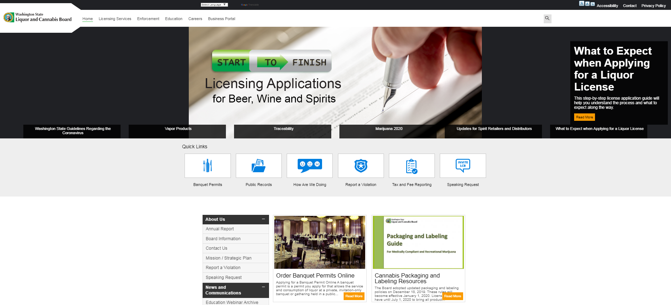
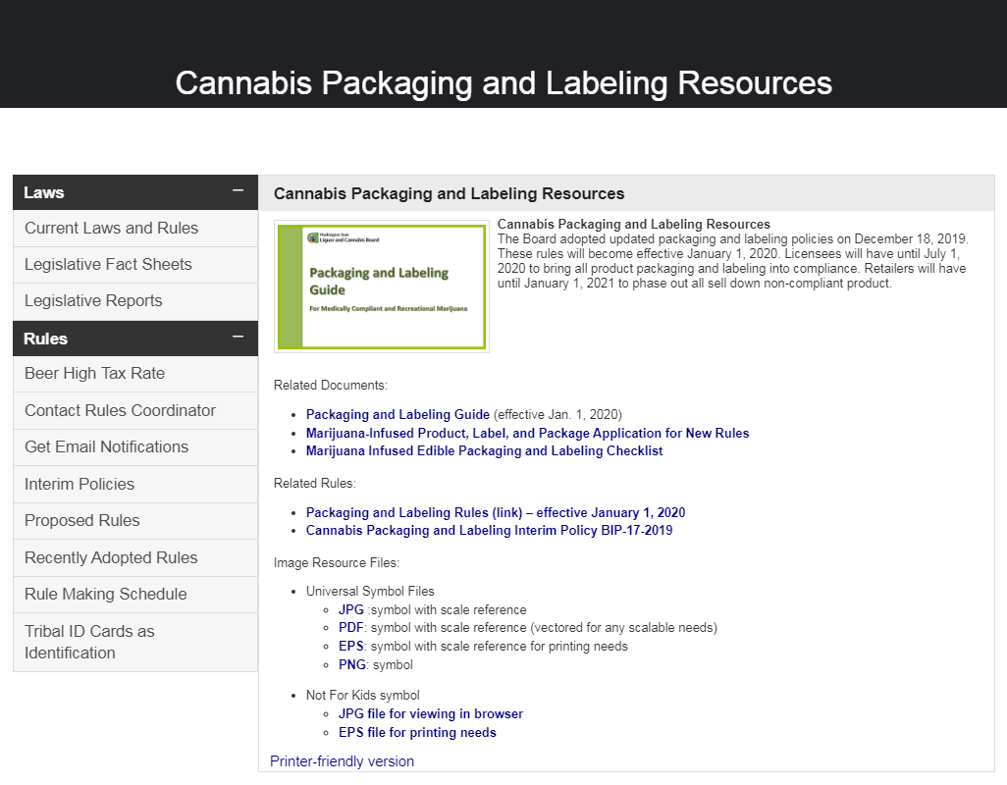
Cannabis Packaging and Labeling Resources
Link to the Packaging and Labeling Guide is located on the agency website home page https://lcb.wa.gov/laws/labeling-resources
Notes:
In addition to this training, there is a Packaging and Labeling Guide for cannabis on our agency website. This is a good tool to assist with questions licensees may have. An updated guide should be available Spring 2022.

Slide 3
Rule Changes Effective January 1, 2020
WAC 314-55-077(8) “Marijuana-infused edible products in solid or liquid form must be homogenized to ensure uniform disbursement of cannabinoids.
WAC 314-55-077 (9) A marijuana processor may infuse food or drinks with marijuana, provided that:
(a) The product or products do not require cooking or baking by the consumer;
(b) Coatings applied to the product or products are compliant with the requirements of this chapter; and
(c) The product and package design is not similar to commercially available products marketed for consumption by persons under twenty-one years of age, as defined by WAC 314.55.105 (1)(c).
WAC 314-55-105 (1) Updated definition of cartoon and especially appealing to persons under the age of twenty-one.
Notes:
For rules changes effective January 1, 2020, licensees had until July 1 to ensure their products, packaging and labeling were compliant with new rules.
Retailers had until December 31 to sell down or phase out any existing non-compliant products, packaging and labeling that were in stores.
ALL cannabis products in stores had to be compliant with the new rules as of January 1, 2021.
For any remaining non-compliant products, packaging or labeling licensees were directed to dispose of those products accordingly. This was outlined in Board Interim Policy 17-2019.
Changes to WAC 314-55-077 were: Section (8), the word throughout was removed referring to homogenization. Now, licensees must ensure uniform disbursement of cannabinoids in the cannabis product. This allows for processors to purchase commercially manufactured products and infuse them with cannabis.
Section (9), listing out specific product types of cotton candy, lollipops and gummies were removed. By removing those product types, did not mean they are automatically approved to infuse.
The definition for cartoon and especially appealing to persons under the age of twenty one was also updated in WAC 314-55-105.

Slide 4
Required Disclosure
This applies to all cannabis products. Licensees must disclose all of the chemicals, compounds, additives, thickening agents, terpenes, or other substances added to any marijuana concentrate during or after production.
Notes:
Licensees must disclose all of the chemicals, compounds, additives, thickening agents, terpenes, or other substances added to any marijuana concentrate during or after production.
If this does not apply to the cannabis product, the licensee does not have to do anything further with their packaging or labeling.

Slide 5
Packaging Changes
Marijuana edibles in solid form must be packaged:
(i) In child resistant packaging consistent with 16 C.F.R. Part 1700, Poison Prevention Packaging Act; or
(ii) In plastic that is two mil or greater in thickness, heat sealed without an easy-open tab, dimple, corner, or flap that will protect persons under the age of twenty-one from accidental exposure to marijuana edibles in solid form.
Marijuana edibles in liquid form that include more than one serving must be packaged with a re-sealable closure or cap. Marijuana edibles in liquid form must include a measuring device such as a measuring cup or dropper. Hash marks on the bottle or package qualify as a measuring device.
Notes:
The thickness of the plastic was revised from 4mil to 2mil or greater for cannabis infused edibles and concentrates.
Hash marks on the bottle now qualify as a measuring device. You must be able to see the product through the hash marks to ensure the consumer is able to accurately measure a proper serving.

Slide 6
Prohibited information
Labels for cannabis must not contain any statement, depiction, or illustration that:
Is false or misleading, consistent with guidance provided in 21 C.F.R. Sec. 101.18(a);
Promotes over consumption;
Represents that the use of marijuana has curative or therapeutic effects;
Depicts a person under the age of twenty-one consuming marijuana, or is especially appealing to persons under twenty-one years of age.

Slide 7
Child Resistant Packaging
Marijuana concentrates and infused edibles must be packaged:
(i) In child resistant packaging consistent with 16 C.F.R. Part 1700, Poison Prevention Packaging Act; or
(ii) In plastic that is two mil or greater in thickness, heat sealed without an easy-open tab, dimple, corner, or flap that will protect persons under the age of twenty-one from accidental exposure.
Notes:
Child resistant packaging is to reduce the risk of poisoning in persons under the age of twenty-one through the ingestion of cannabis concentrates, and cannabis-infused edible products.
The packaging must be designed or constructed to be significantly difficult for children under five years of age to open within a reasonable time, and not difficult for normal adults to use properly to meet the requirements of Title 16 C.F.R. Part 1700 - Poison Prevention Packaging Act.
If there is question from the licensee whether or not their packaging is child resistant, they can get a certification from the packaging manufacturer that validates the packaging is certified child resistant. The licensee should have that information should it be requested by LCB.

Slide 8
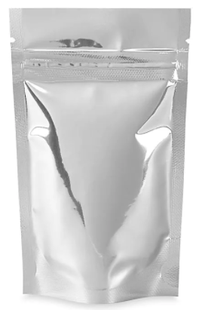
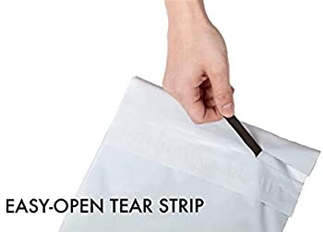
What does easy-open mean?
Plastic that is two mil or greater in thickness, heat sealed without an easy-open tab, dimple, corner, or flap that will protect persons under the age of twenty-one from accidental exposure to cannabis.
Notes:
Cannabis concentrates and infused edibles must be packaged in plastic 2 mil or greater in thickness heat sealed without an easy-open tab, dimple, corner, or flap that will protect persons under the age of twenty-one from accidental exposure to cannabis. Here are examples of what packages with easy-open may look like. These examples are not all inclusive.

Slide 9
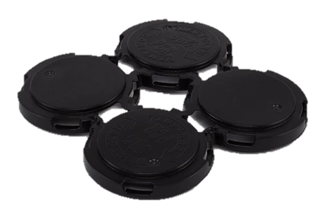
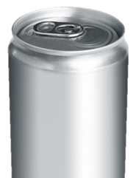
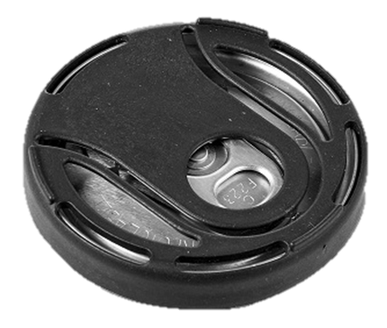
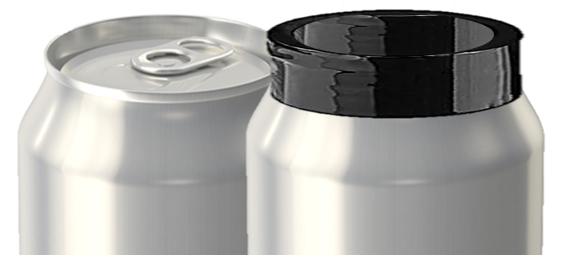
Easy-Open Pop Top
While an easy open pop-top by itself would be prohibited per WAC 314-55-105, it could be approved for single servings with child resistant packaging consistent with 16 C.F.R. Part 1700, Poison Prevention Packaging Act.
Pak-Tech type top | A child resistant can cover | Heat shrink plastic 2 mil or greater with no easy open option
Notes:
While an easy open pop-top by itself would be prohibited per WAC 314-55-105, it could be approved for single servings with child resistant packaging. Can toppers such as, but not limited to these could meet the child resistant requirement. This type of packaging would be reviewed and approved on a case by case basis.
These examples are not all inclusive.
A Pak-Tech type top
A CR can topper
Plastic 2mil or greater heat sealed with no easy-open tab, dimple, corner, or flap

Slide 10
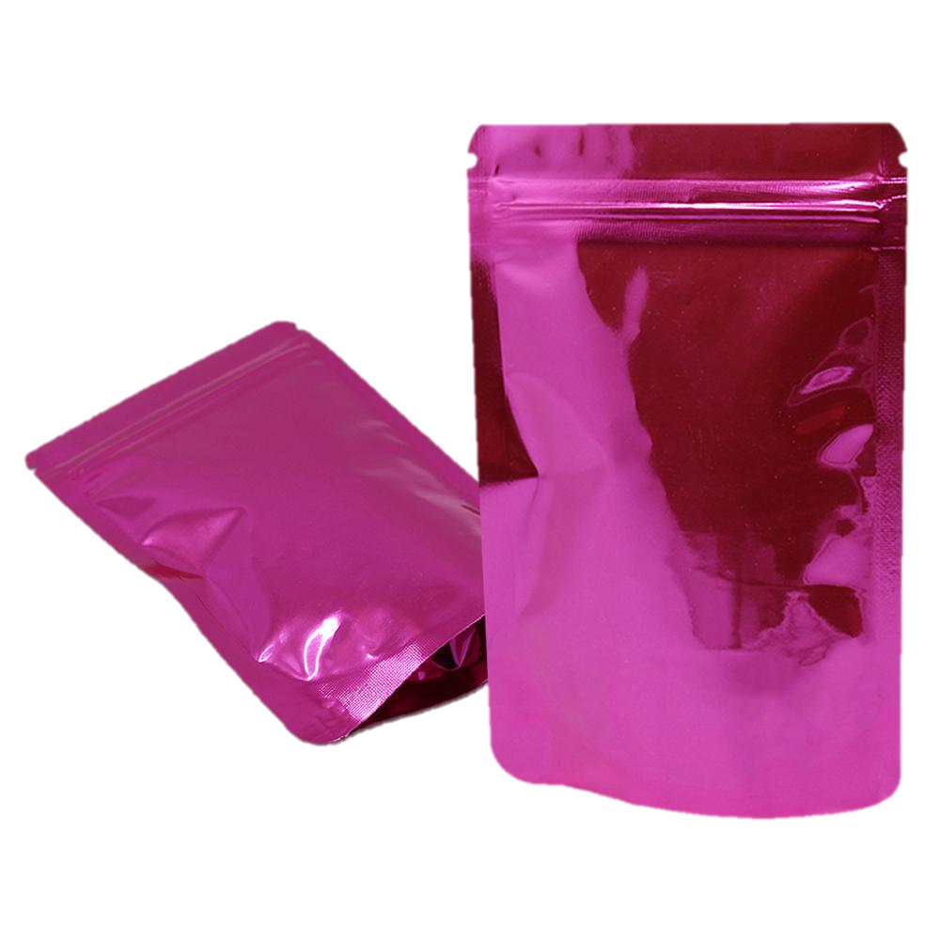
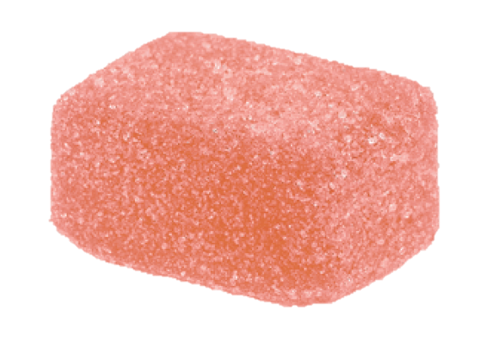
Easy-Open Dimple
If the product inside the bag is loosely packaged, this bag is considered non-compliant child resistant packaging. This is an easy open dimple.
If each product inside the bag is heat sealed in plastic 2mil or greater, the outer bag would be considered compliant.
The heat sealed plastic meets the child resistant packaging requirement therefore the outer packaging does not need to be child resistant.
Notes:
Cannabis concentrates and infused edibles are required to be packaged in child resistant packaging. The outer package does not have to be child resistant if the product inside the outer package is in child resistant packaging.

Slide 11
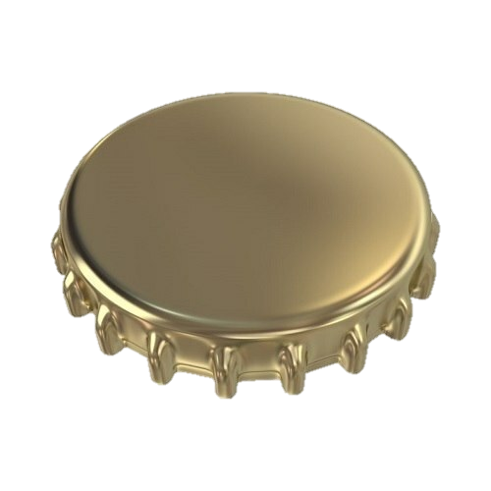
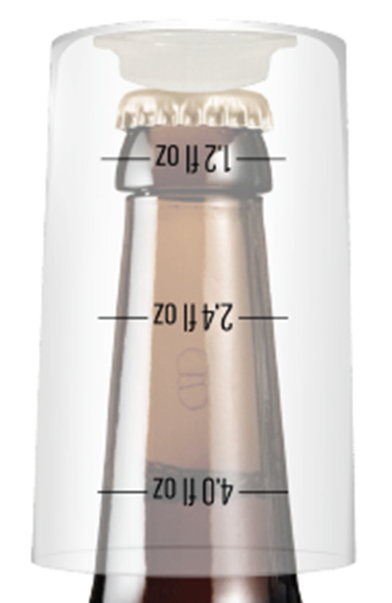
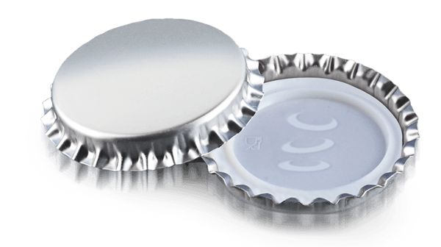
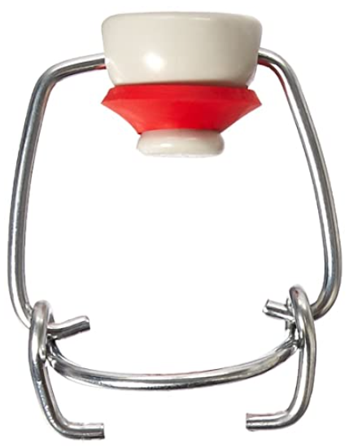
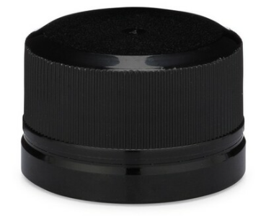
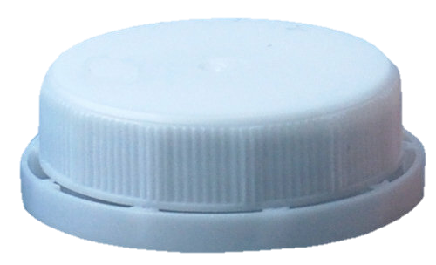
Re-sealable Cap and Closure
Marijuana liquid edibles that include more than one serving must be packaged with a re-sealable closure or cap.
1.
3.
5.
7.
2.
4.
6.
Notes:
Marijuana edibles in liquid form that include more than one serving must be packaged with a re-sealable cap or closure.
Caps or closures such as, but not limited to these “could be” approved. Rule does not state that the re-sealable cap has to be child resistant.
For example, a Metal Crown Cap (1)
This cap can be used only if the cap is a twist-off and can be securely resealed. If it has to be pried off or cannot be securely resealed it would be non-compliant.
The following caps could be compliant if they can be securely resealed.
2. EZ Cap Swing Top
3. Metal Screw Cap
4. Plastic Tamper-Evident Cap
5, 6, and 7. Plastic Bottle Caps

Slide 12
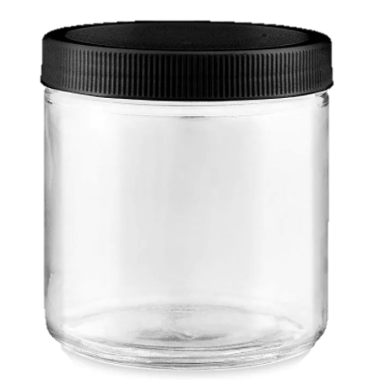
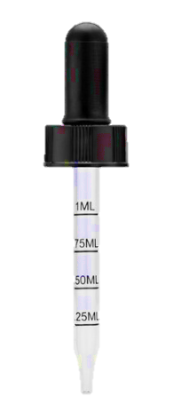
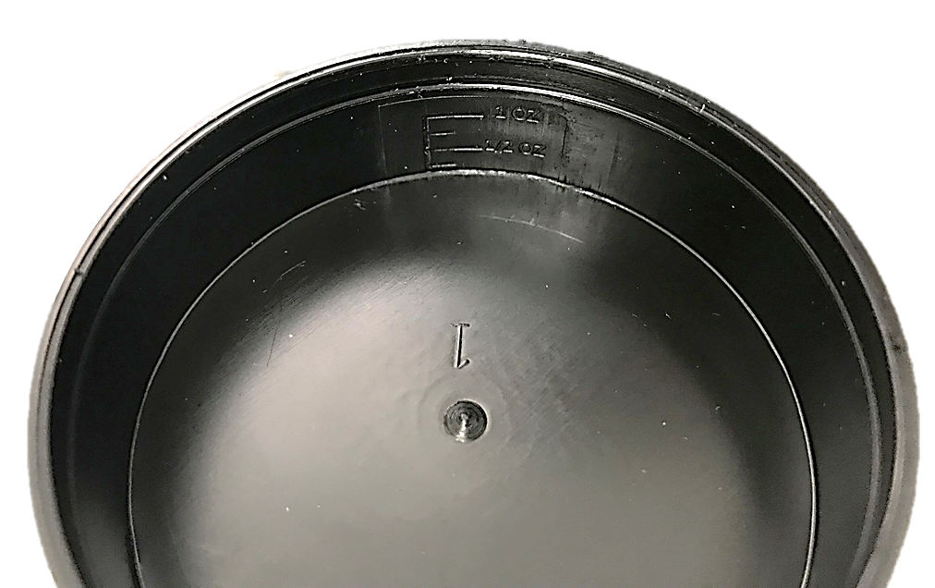
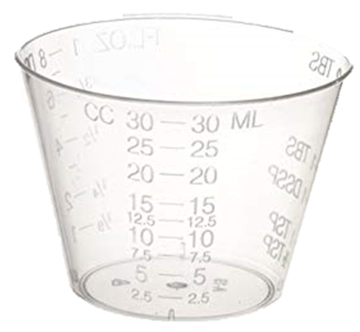
Measuring Device
Marijuana edibles in liquid form must include a measuring device such as a measuring cup or dropper. Hash marks on the bottle or package qualify as a measuring device.
A syringe with measurements
A cup with serving size
Bottle with hash marks
Jar with hash marks indicating each serving
Cup that has a “fill to” line or something similar that indicates the serving size
Dropper with measurements
The actual cap of the bottle serves as the measuring device
3.
7.
4.
6.
serving
2.
serving
5.
1.
Notes:
Marijuana edibles in liquid form must include a measuring device such as a measuring cup or dropper. Hash marks on the bottle or package qualify as a measuring device. Examples such as but not limited to these would qualify as a measuring device.
A syringe with measurements
A cup with serving size
Bottle with hash marks
Jar with hash marks indicating each serving
Cup that has a “fill to” line or something similar that indicates the serving size
Dropper with measurements
The actual cap of the bottle serves as the measuring device

Slide 13
Useable vs. Concentrate
If a processor infuses useable cannabis (a pre-rolled joint) with a concentrate, the joint becomes a concentrate and must follow packaging and labeling, serving and transaction limits for concentrates.
A concentrate unit (serving size) cannot exceed one gram. A unit is equal to one product. | Transaction limit is seven grams of marijuana-infused extract or marijuana concentrate for inhalation. A package may contain up to seven, one-gram infused joints in a package.
Notes:
If a processor infuses useable cannabis with a concentrate, (know as a pre-rolled joint) the joint becomes a concentrate and must follow packaging and labeling, serving and transaction limits for concentrates outlined in WAC-314-55-095. Although concentrates do not have a designated “serving size”, rule does speak to “a single unit of marijuana concentrate cannot exceed one gram.” In this case, a unit would be one infused joint.
Licensees can package up to seven one gram or less infused joints into one package.

Slide 14
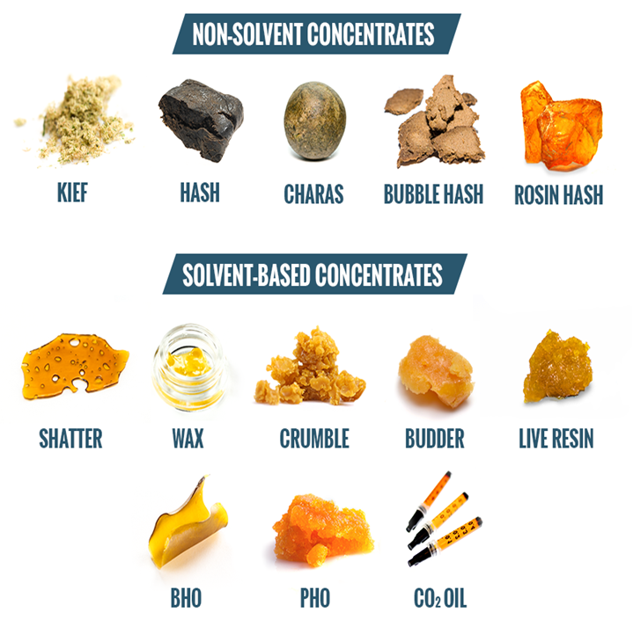
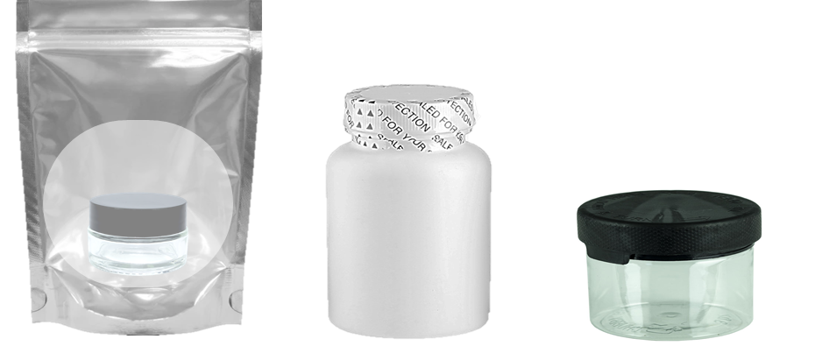
Concentrates
A concentrate must be packaged in child resistant packaging consistent with 16 C.F.R. Part 1700, Poison Prevention Packaging Act; or In plastic that is two mil or greater in thickness, heat sealed without an easy-open tab, dimple, corner, or flap.
Child resistant re-sealable bag (Multiple use product)
Heat seal around lid (One time use product)
Child resistant lid (Multiple use product)
Child resistant lid (One time use product)
Notes:
Concentrates must be packaged in child resistant packaging for the life of the product. Options for compliant packaging could be but are not limited to these examples.
The jar itself can be child resistant
The jar could have a plastic (two mil or greater) heat sealed sleeve around the lid
The outer bag could be re-sealable and child resistant without an easy-open tab, dimple, corner, or flap

Slide 15
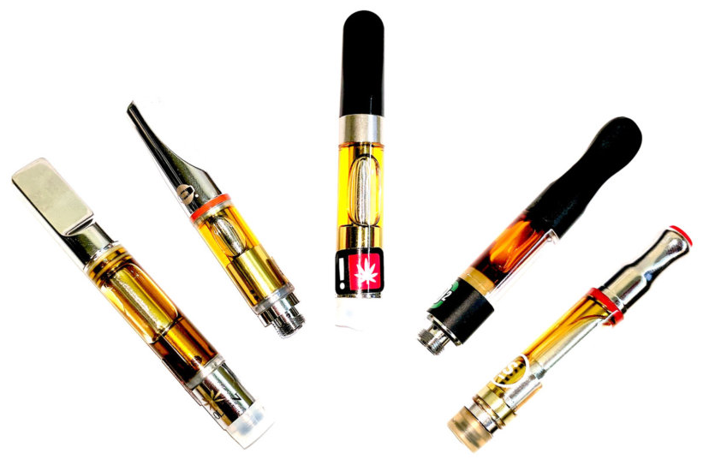
Vape Cartridges
The vape cartridge is part of the paraphernalia (or function of the product), not packaging. The outer packaging must meet the child resistant packaging requirement.
Exception would be if the cartridge itself is certified child resistant. A licensee would need to have the certification from the manufacturer on file.
Notes:
The vape cartridge is part of the paraphernalia (or function of the product) and is not the packaging. The outer packaging must meet the child resistant packaging requirements. Exception would be if the cartridge itself is certified as child resistant. A licensee would need to have the certification from the manufacturer on file.
If the vape cartridge itself is child resistant, then the outer package would not have to be. There are only a few manufacturers that have child resistant certified cartridges. Just because a cartridge is pressed together or difficult to get apart, it does not make it child resistant product. It is up to the licensee to validate the status of the cartridge if there is a question with the packaging.

Slide 16
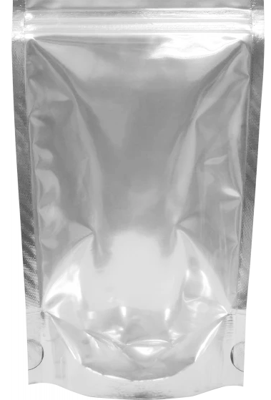
Concentrate and Vape Cartridge Packaging
Wrap around plastic sides and a small glue dot is not compliant with child resistant packaging. | If the plastic tube the cartridge is in is certified child resistant, this packaging would be considered compliant. If not, then this packaging (tube and box) are considered non-compliant. | This appears to be compliant packaging. Heat sealed in 2mil or greater plastic with no easy open tab, dimple, corner, or flap. | This appears to be an easy-open option with the perforation and would make this packaging non-compliant.
Notes:
All cannabis concentrates are required to be in child resistant packaging. The packaging must be heat sealed in 2mil or greater plastic or compliant with the child resistant packaging requirements.
The first example does not appear to meet that requirement. It is a cardboard backing with plastic cover over it with two small glue dots holding the two pieces together. The exception would be IF the syringe itself is certified as child resistant packaging by the manufacturer, this would be complaint.
The second one would be compliant IF the plastic tube the cartridge is in, or the cartridge itself is certified child resistant. If not, the packaging including the tube, cartridge and box are considered non-compliant.
The third one appears to be compliant packaging. Heat sealed in 2mil or greater plastic with no easy open tab, dimple, corner, or flap
The fourth one appears to have an easy-open option with the perforation on the back. This would make this packaging non-compliant.

Slide 17
Pesticide Disclosure
Pesticide testing is only required for products that are Department of Health compliant.
Listing pesticide information such as but not limited to “may have or could have been used” is non-compliant. The licensee must list the product specific pesticide product(s) used.
If cannabis from multiple lots are used, pesticide information must be listed for each lot.
No residual pesticides in the finished product does not mean it is pesticide free. The pesticide requirement applies to the pesticide used in the growing process. Any type of pesticide used during the growing process is required to be listed.
If no pesticides were applied to the marijuana plants and growing medium during production, it is acceptable to list “no pesticides used” or “pesticide free”.
It would be considered false and misleading if pesticides were used but it is listed as pesticide free.
Notes:
Pesticide information must be provided for as long as the product is for sale. It can be provided via an internet link, web address, or QR code on the label. It can be listed on the actual packaging or labeling or by accompanying material at the time of purchase.
Pesticide information must be product specific. If a licensee has used multiple lots of cannabis to manufacture their end product, they must list pesticide information for all lots used. Processors can obtain pesticide information from the producer.
Licensees may not use terms such as but not limited to: may have, could have been used or used if necessary. This does not inform the consumer what was actually used with the product.
Pesticide information is required. Many licensees list “pesticide free” on their packaging. Licensees can not list false or misleading information. I take it for face value and do not require the licensee to validate the statement.
Natural pesticides such as ladybugs or an all-organic product are still considered to be a pesticide. Pesticide free does not mean there are no residual pesticides in the end product. It means there were no pesticides applied to the marijuana plants and growing medium during production.

Slide 18
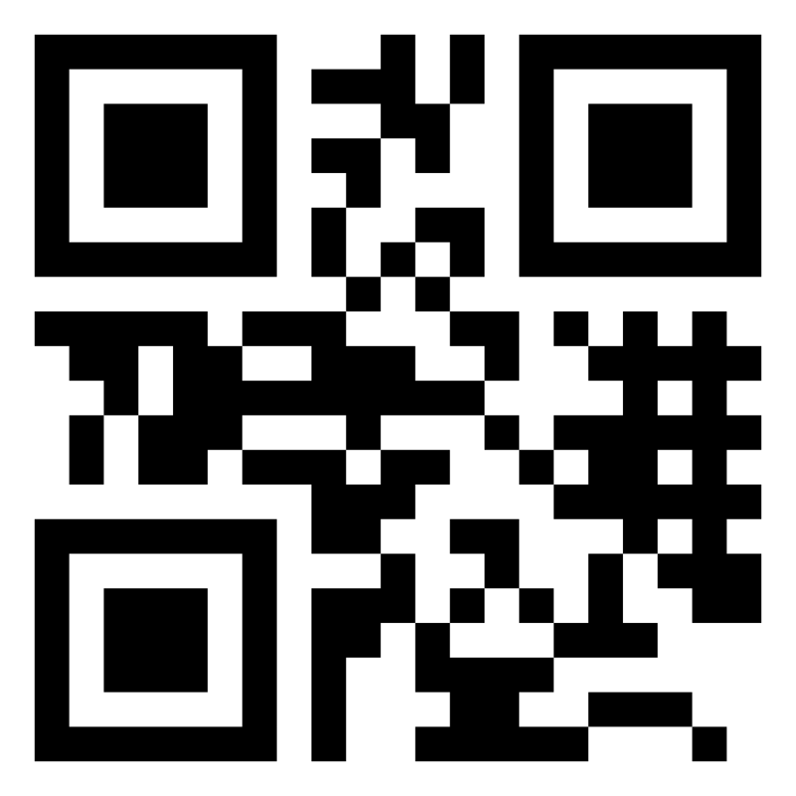
Ways to Provide Pesticide Information
With the product via written material at the time of the purchase
On the label or on the packaging
Via internet link or web address
QR Code
Product name Total: THC XXmg, THCA XXmg CBD XXmg, CBDA XXmg Extraction method: Ethanol Pesticide(s) used: AzaGuard Producer name and UBI number Processor name and UBI number
WASL012456.IT3GX
For pesticide ABCannabis@ABC.com/Pesticide-Info for details
Notes:
Here are some examples you may see for how licensees provide pesticide information.
Accompanying material with the product: The retailer would provide the consumer printed material provided by the processor with the product specific information included at the time of sale.
On the label: Typically on a retail or barcode label.
Via internet link or web address to the producer/processors site(s) on the packaging or labeling.
QR Code on the packaging or labeling.
When a consumer is directed to a website for pesticide information, it needs to direct the consumer to the actual information or be easily found on the licensees website. Consumers should not have to search for the information.

Slide 19
Required Symbols
Required for all infused edible product packaging
Not For Kids
Compliant
Non-Compliant
.75”
.5”
A black border is required when placed on a white background.
Symbol must remain the color as designed.
Required on all cannabis product packaging
Universal Symbol
Compliant
Non-Compliant
.75”
.75”
Notes:
Cannabis-infused products for oral ingestion sold at retail must be labeled on the principal display panel or front of the product package with the "not for kids" warning symbol and must not be smaller than three-quarters of an inch in height by one-half of an inch in width. The warning symbol must not be altered or cropped in any way with the exception of a black border around the edges of the white background when the packaging or label is also white to ensure visibility of the warning symbol.
All cannabis products sold at retail must be labeled on the principal display panel or front of the product package with the cannabis universal symbol and must not be smaller than three-quarters of an inch in height by three-quarters of an inch in width. The universal symbol must not be altered or cropped in any way. Must be upright as designed. Must be the same colors as designed.
“Principal display panel" means the portion(s) of the surface of the immediate container, or of any outer container or wrapping, which bear(s) the labeling designed to be most prominently displayed, shown, presented, or examined under conditions of retail sale. "Immediate container" means the external container holding the marijuana product.

Slide 20
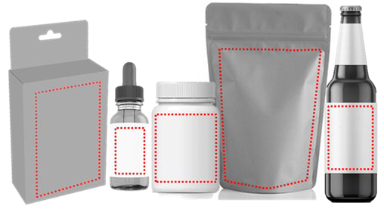
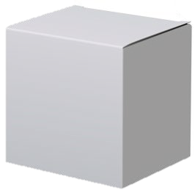
Principal Display Panel
Notes:
Here are examples of areas highlighted by the red dotted lines that would be considered the principal display panel.

Slide 21
Business Name and Unique Identifier Number
The business or trade name and unified business identifier number must be listed for both the producer and processor. If there is cannabis from more than one producer used to manufacture the product, information must be listed for all producers. Same for processors. If there are more than one processor used to manufacture the product then all processors information must be listed.
The lot number of the product (the unique identifier number generated by the board's traceability system). This must be the same number that appears on the transport manifest.
This number can be listed on a separate label and applied to the packaging.
Notes:
The business or trade name and unified business identifier number (UBI) must be listed for both the producer and processor. If there is more than one producers cannabis that was used to manufacture the end product, the licensee must list them all. If there was more than one processor that was used to manufacture the end product, the licensee must list them all.
The lot number of the product or the unique identifier number generated by the board's traceability system must be the same number that appears on the transport manifest.
This number can be listed on a separate label and applied to the packaging.

Slide 22
The serving size and the number of servings contained within the unit
If more than one serving is in an infused edible package, the label must prominently display the serving size, the number of servings in the package and the amount of product per serving:
Solid example: 10 servings | 10mg THC per serving | 1 serving = 1 piece
Solid example: 10 servings | 10mg THC, 10mg CBD per serving | 1 serving = 1 piece
Liquid example: 10 servings | 10mg THC per serving | 1 serving = 1 fl.oz.
Liquid example: 10 servings | 10mg THC, 20mg CBD per serving | 1 serving = 1 fl.oz.
Notes:
If more than one serving is in an infused edible package, the label must prominently display the serving size, the number of servings in the package and the amount of product per serving.

Slide 23
Net Weight
Net weight in ounces and grams or volume as applicable.
Example:
Solids – 3 oz. (85g)
Liquids – 4 fl.oz. (118mL)
100mg THC
Premium Chocolates
NET WT 4.4 Oz. (125g)
10 servings | 10mg per serving 1 piece = 1 serving
NET WT 4.4 Oz. (125g)
Notes:
Net weight must be listed in ounces and grams or volume as applicable for all products. For a solid products it would be in ounces and grams and for a liquid products it would be in fluid ounces and milliliters.

Slide 24
Total THC,THCA,CBDA and CBD
THC and THCA can be added together for a total milligram of THC.
CBD and CBDA can be added together for a total milligram of CBD.
The total THC and CBD cannot be added together for a total milligram without listing the totals separately.
100 MG THC | < 25 MG CBD
10 servings per package
10 MG THC, <2.5MG CBD per serving
Net Weight 1.4oz (40g)
The less than symbol is allowed on the front of the packaging if the actual amount of the THC and CBD are listed elsewhere on the packaging. The amount must be clearly visible and is not obstructed to the consumer.
Notes:
THC and THCA can be added together for a total milligram of THC.
CBD and CBDA can be added together for a total milligram of CBD.
The total THC and CBD cannot be added together for a total milligram without listing the totals separately.
The less than symbol is allowed on the front of the packaging if the actual amount of the THC and CBD are listed elsewhere on the labeling. The amount must be clearly visible and is not obstructed to the consumer.

Slide 25
Cannabis Extraction
If solvents were used, a statement that discloses the type of extraction method, including any solvents, gases, or other chemicals or compounds used to produce or that were added to the extract must be listed on the packaging.
Total Per Package 100mg 50mg CBD THC
10 servings | 10mg per serving 1 piece = 1 serving
WARNING: May be habit forming. Unlawful outside Washington State. It is illegal to operate a motor vehicle while under the influence of marijuana. CAUTION: Intoxicating effects may be delayed by 2+ hours.
This product is made from CO2 extracted cannabis.
No pesticides applied to the marijuana plants and growing medium during production of the marijuana.
This product is made from CO2 extracted cannabis.
Notes:
For cannabis extraction, licensees are required to provide a statement that discloses the type of extraction method, including any solvents, gases, or other chemicals or compounds used to produce or that were added to the extract.
This is an example from one of the licensees for a product in retail stores.

Slide 26
Cartoon
"Cartoon" means any drawing or other depiction of an object, person, animal, creature, or any similar caricature that meets any of the following criteria:
(i) The use of comically exaggerated features;
(ii) The attribution of human characteristics to animals, plants, or other objects;
(iii) The attribution of animal, plant, or other object characteristics to humans;
(iv) The attribution of unnatural or extra-human abilities.

Slide 27
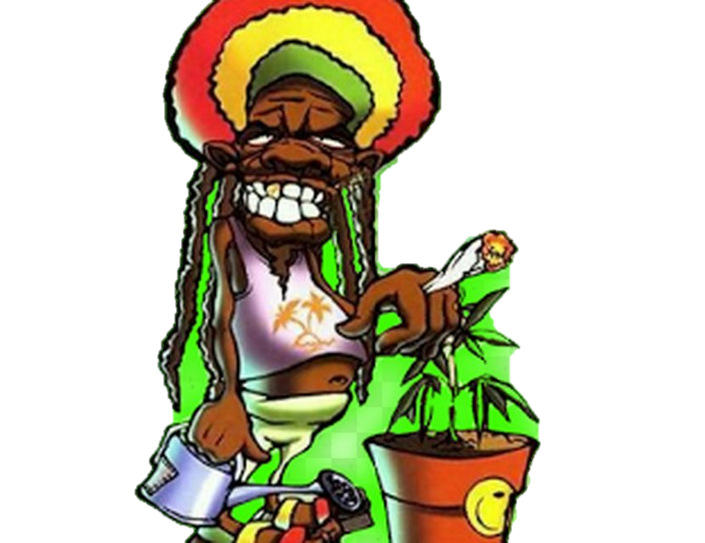
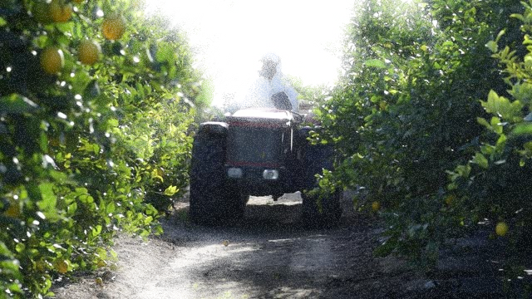
Cartoons
Non-Compliant Compliant
Non-Compliant Compliant
Non-Compliant Compliant
Sour Diesel
Sour Diesel
Fire Hot
Fire Hot
Sour Diesel
Notes:
Images can be used on packaging or labeling as long as they are compliant with rule. For example:
Blueberries do not have faces, but an image of a blueberry without facial features could be used.
Gorillas do not wear hats, sunglasses or smoke but an image of a gorilla not doing those things could be used.
Images of a person with facial features and body structure that are exaggerated are non-compliant, but an image of a person with normal facial features and body structure could be used.
Flamingos with exaggerated features such as large eyes or wearing sunglasses are non-compliant , but an image of a flamingo could be used.
Fire does not have facial features, but fire could be used.
Lemons do have human characteristics or drive tractors but a farmer driving a tractor could be used.

Slide 28
Especially Appealing to Persons Under the Age of Twenty-One
New definition of Especially Appealing to Persons Under the Age of Twenty-One effective January 1, 2020
(i) The use of cartoons;
(ii) Bubble-type or other cartoon-like font;
(iii) A design, brand, or name that resembles a non-cannabis consumer product that is marketed to persons under the age of twenty-one;
(iv) Symbols or celebrities that are commonly used to market products to persons under the age of twenty-one;
(v) Images of persons under the age of twenty-one; or
(vi) Similarities to products or words that refer to products that are commonly associated or marketed to persons under the age of twenty-one.
Notes:
The following slides will show examples of what especially appealing to persons under the age of twenty-one could look like.

Slide 29
Bubble or Cartoon Like Font
Notes:
Examples of what a bubble or cartoon like font may look like.

Slide 30
A design, brand, or name that resembles a non-cannabis product marketed to persons under the age of twenty-one
Notes:
A design, brand, or name that resembles a non-cannabis product marketed to persons under the age of twenty-one
Adidas is an apparel, shoe and accessory brand that is marketed to all ages however; that includes marketing specifically to persons under the age of twenty one.
Hollister is an apparel brand that is market to those under the age of twenty one.

Slide 31
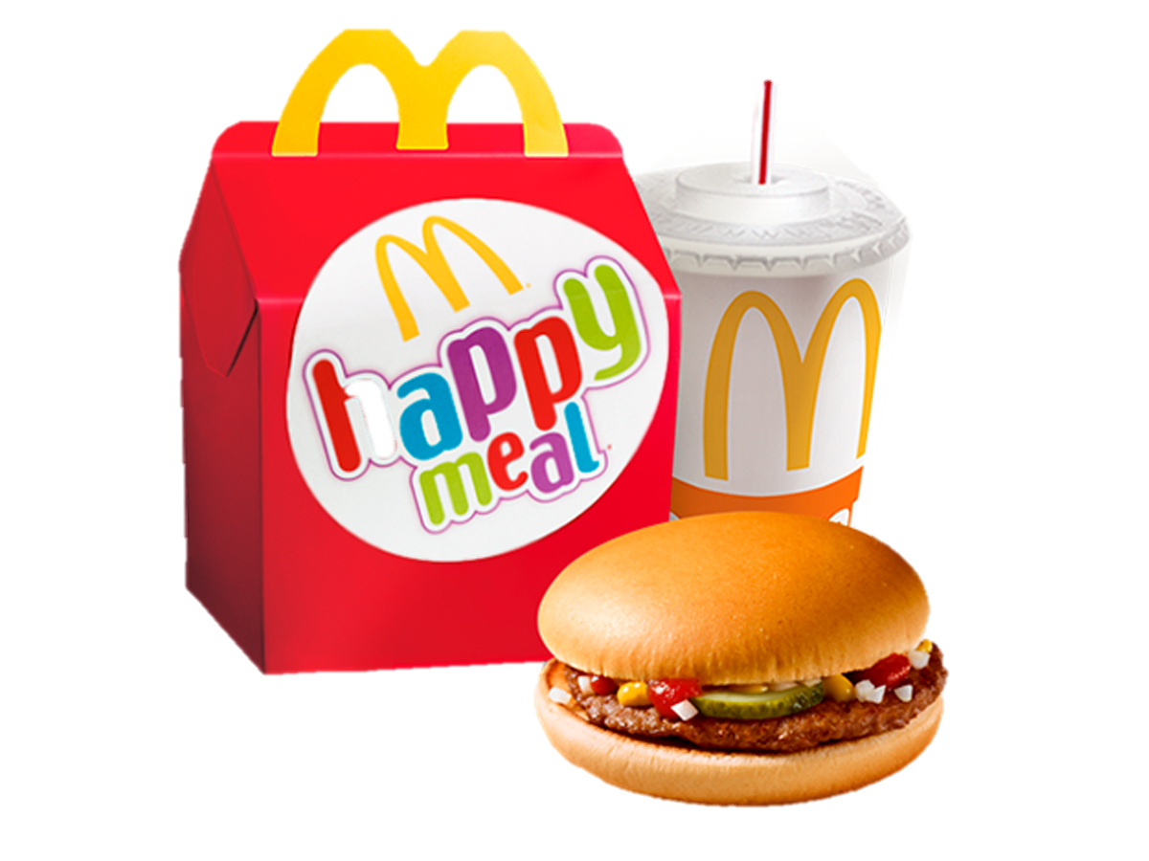
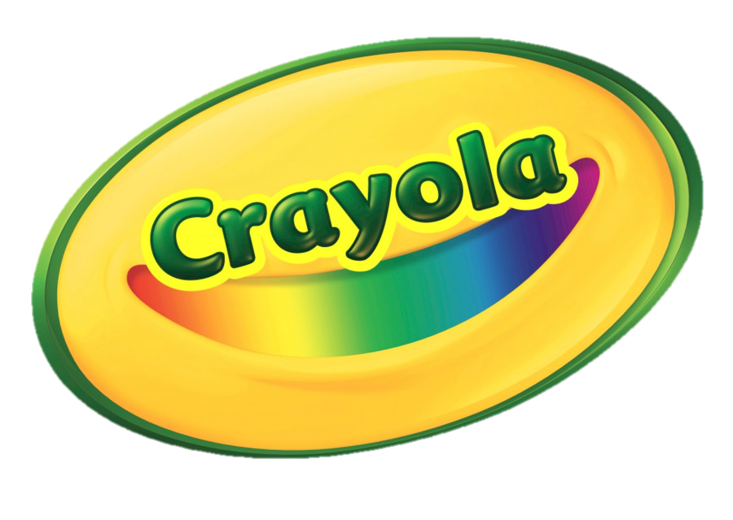
Symbols or celebrities that are commonly used to market products to persons under the age of twenty-one
Notes:
These are examples of symbols or celebrities that are commonly used to market products to persons under the age of twenty-one

Slide 32
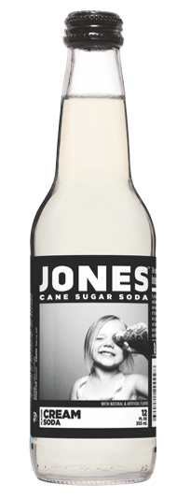
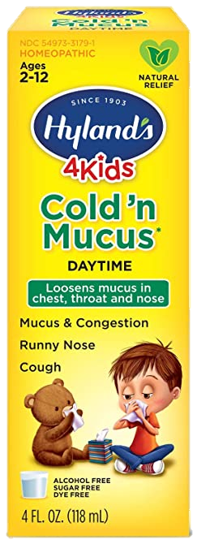
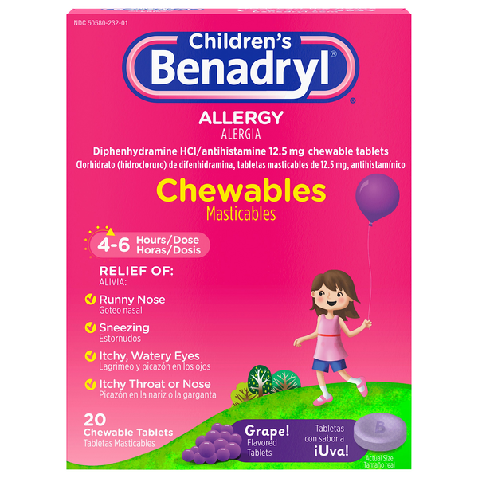
Images of persons under the age of twenty-one
Notes:
Examples of non-cannabis consumer products that use images of persons under the age of twenty-one. This is prohibited for all cannabis products.

Slide 33
Similarities to products or words that refer to products that are commonly associated or marketed to persons under the age of twenty-one.
Notes:
Examples of similarities to products or words that refer to products that are commonly associated or marketed to persons under the age of twenty-one. This is a comparison of non cannabis consumer products on the left and cannabis products on the right.

Slide 34
Department of Health Compliant Products
A general use product is any marijuana product allowed by the WSLCB, including edibles, flowers and concentrates. Packaged servings may be packaged in servings or applications that contain up to 10 mg of active THC. A unit must not contain more than 10 servings or applications and must not exceed 100 mg total of active THC.
High CBD products are any marijuana product allowed by the WSLCB, including edibles - except marijuana intended for smoking. Concentrates containing no more than 2 percent THC concentration and at least 25 times more CBD concentration by weight. Marijuana-infused edible products that contain no more than 2 mg of active THC and at least five times more CBD per serving by weight for solids or volume for liquids. Marijuana-infused topical products containing at least five times more CBD concentration than THC concentration.
High THC products are marijuana products containing more than 10 mg but not more than 50 mg of active THC per serving or application. Only the following types of marijuana products qualify for High THC classification: capsules, tablets, tinctures, transdermal patches, and suppositories. Packaged Servings High THC compliant products may be packaged in servings or applications containing up to 50 mg of active THC. A unit must not contain more than 10 servings or applications and must not exceed 500 mg total of active THC.
Notes:
All compliant products require mandatory testing for prohibited pesticides, heavy metals and mycotoxins.
All products require the Department of Health applicable logo and the statement that reads: "This product is not approved by the FDA to treat, cure, or prevent any disease.“
Packaging for all products utilizing a Chapter 246-70 WAC must NOT:
Use any word(s), symbol, or image commonly used in or by medical or pharmaceutical professions including, but not limited to depiction of a caduceus, staff of Asclepius, bowl of Hygeia, or mortar and pestle.
Use of the word "prescription" or letters "RX."
State or imply any specific medical or therapeutic benefit.
Mimic a brand of over-the-counter or legend drug.
DOH rules differ from LCB rules:
For General Use DoH compliant products, it is 10mg THC per serving or applications and must not exceed 100mg THC.
LCB rule is 10 servings or 100 milligrams THC. Which means infused product that are not DoH General Use products could have 20 servings per packaging with 5mg THC per serving per LCB’s rules.

Slide 35
Department of Health Compliant Products
* All purchases made by a recognized cardholder are sales tax free
+ Any adult may purchase High CBD compliant sales tax free
Notes:
Patients and designated providers with recognition card may purchase any of the three product types sales tax free. High THC, High CBD and General Use.
Any adult may purchase High CBD or General Use products. They may not purchase High THC products.
Any adult consumer may purchase High CBD compliant products sales tax free.

Slide 36
Structure and Function Claims
Products identified as compliant marijuana product under RCW 69.50.375(4) and chapter 246-70 WAC may include:
A structure or function claim describing the intended role of the product to maintain the structure or any function of the body.
Characterization of the documented mechanism by which the product acts to maintain such structure or function, provided that the claim is truthful and not misleading.
Any product can contain a:
Warning describing the psychoactive effects of the marijuana product.
Notes:
Any structure and function claim may not claim to diagnose, mitigate, treat, cure, or prevent any disease
Compliant products must include the disclaimer, "These statements have not been evaluated by the State of Washington. This product is not intended to diagnose, treat, cure, or prevent any disease.“ In addition to: "This product is not approved by the FDA to treat, cure, or prevent any disease.“
Listing the psychoactive effect requires the disclaimer, "These statements have not been evaluated by the State of Washington. This product is not intended to diagnose, treat, cure, or prevent any disease.“
An agency policy statement will be issued later this year with additional information regarding structure and function claims.

Slide 37
Ingredient / Recipe Approval
As of April 1, 2018, the Washington State Department of Agriculture (WSDA) assumes regulatory authority to license and regulate makers of food products that contain marijuana. This requires processing businesses to apply for a special endorsement on their business licenses.
WSDA's Food Safety Program regulates, inspects and provides technical assistance to food processors regarding product safety issues and now will conduct similar activities with marijuana infused edible (MIE) processors. These activities include assessing facility construction, equipment, cleaning and sanitizing practices, allowable products, labeling, and carrying out enforcement and recalls when necessary.
The WSDA ingredient approval must be kept on file at the marijuana processor's licensed premises and made available for inspection by the board or its designee. The approval must be included with all product, packaging and labeling submissions to the LCB.
Beginning January 1, 2021, Marijuana Infused Edible (MIE) products may contain dietary ingredients, if the ingredients are recognized by the FDA and documentation is provided to the WSDA Food Safety Program.
Notes:
Licensed processors who manufacture infused edibles are required to have a Marijuana Infused Edibles Processor endorsement to their business license issued by the WSDA. The WSDA must also approve all infused edible ingredients before LCB can approve products, packaging and labeling for sale in retail stores.
Washington State Department of Agriculture
Email - foodsafety@agr.wa.gov
Phone - 360-902-1876

Slide 38
Thank you
Susan Harrell 360-664-1620 | susan.harrell@lcb.wa.gov
Notes:
This concludes our training for today. If you have any questions, please feel free to reach out to me via email, phone or TEAMS
Susan Harrell | 360-664-1620 | susan.harrell@lcb.wa.gov
I am happy to assist enforcement with non-edible cannabis questions however; I do not generally work with non-edible licensees due to the volume of work that would detail.

