Slide 1
Marijuana Home Grows
Association of Washington Cities
Washington State Association of Counties
Washington State Liquor and Cannabis Board
September 18, 2017

Slide 2
Legislative Directed Study
2017 legislation, ESSB 5131, directs the Washington State Liquor and Cannabis Board (WSLCB) to …
“…conduct a study of regulatory options for the legalization of marijuana plant possession and cultivation by recreational marijuana users.”
The study must consider the federal guidelines provided by the United State Department of Justice in the Cole Memo.
Due December 1, 2017
Findings
Recommendations

Slide 3
Federal Enforcement Guidelines
In addition to Washington’s laws and rules, the Department of Justice issued eight enforcement guidelines for marijuana businesses. These guidelines are separate from Washington’s and are enforced at the discretion of the US Department of Justice.
Eight Guidelines
Preventing distribution to minors.
Preventing the revenue from going to criminal enterprises, gangs and cartels.
Preventing the diversion of marijuana from states where it is legal to other states.
Preventing state-authorized marijuana activity from being used as a cover or pretext for the trafficking of other illegal drugs or other illegal activity.
Preventing violence and the use of firearms in the cultivation and distribution of marijuana.
Preventing drugged driving and other adverse public health consequences associated with marijuana use.
Preventing the growing of marijuana on public lands and the environmental dangers posed by marijuana production on public lands.
Preventing marijuana possession or use on federal property.

Slide 4
Licenses
Issued as of August 28, 2017…
Producer/Processor – 1,363 total licenses
1,038 Producer/Processor
153 Producer only
172 Processor only
Retail
512 licenses statewide

Slide 5
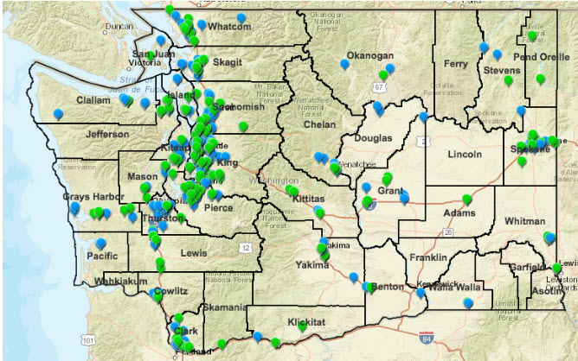
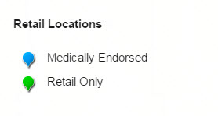
Licensed Retail Locations

Slide 6
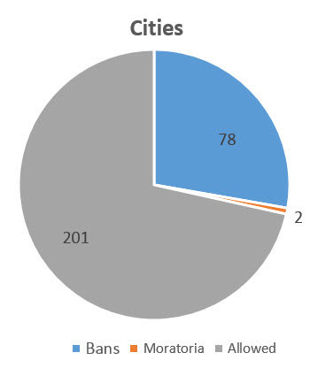
Cities: Bans and Moratoria

Slide 7
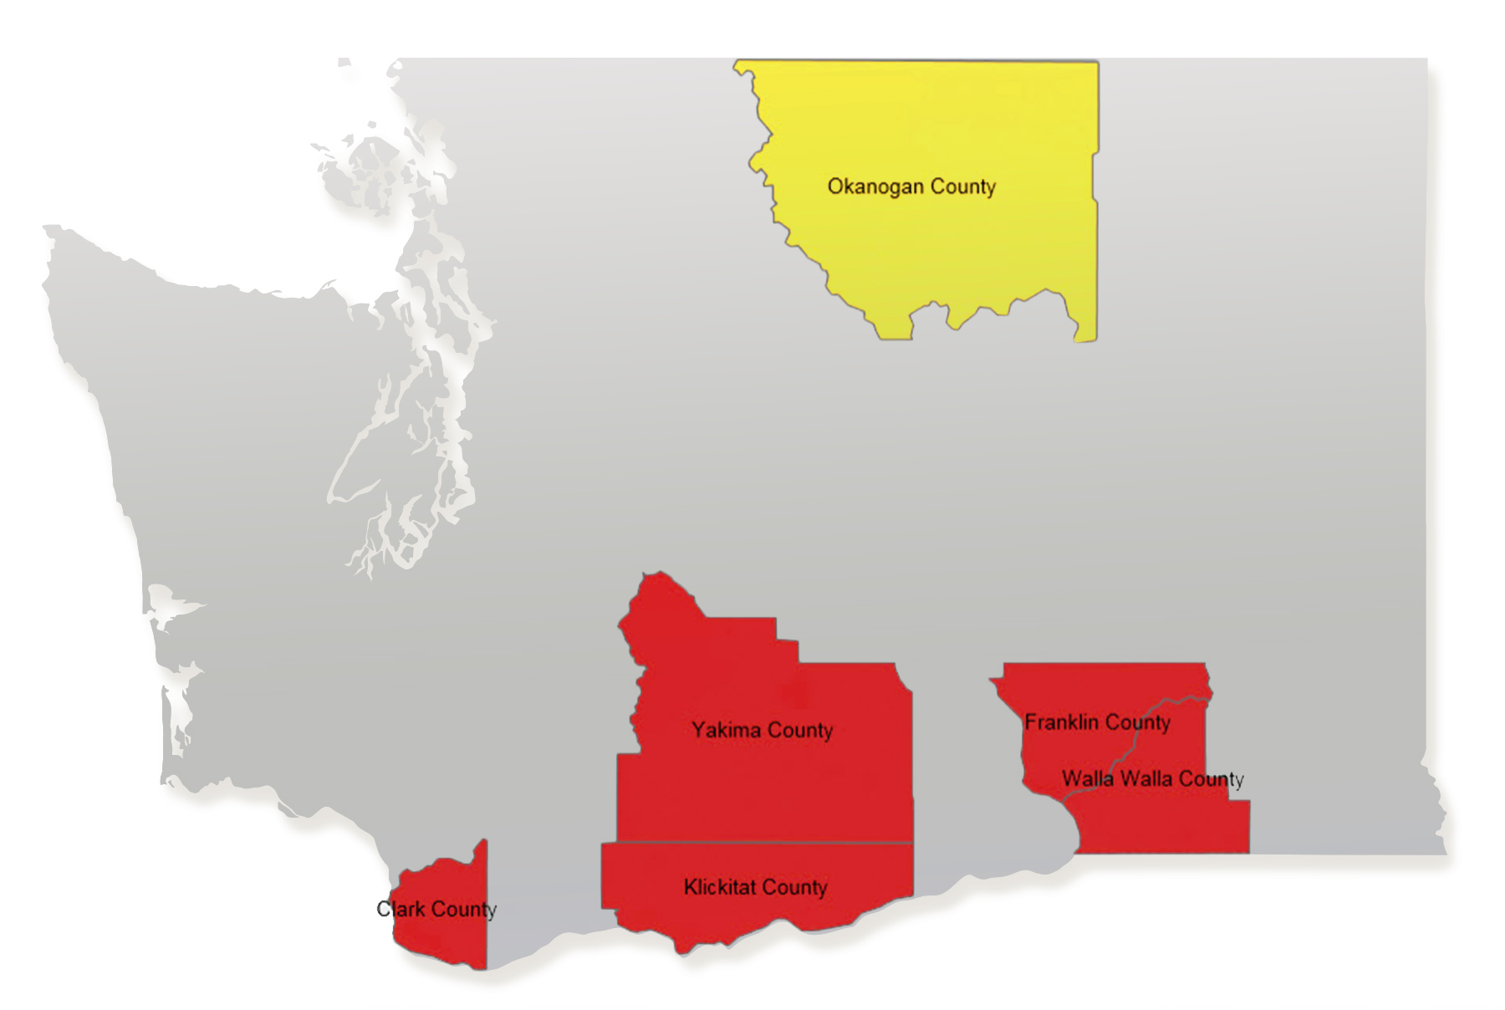
Counties: Bans and Moratoria

Slide 8
Current Status of Home Grows
Washington State is the only state of eight states that does not allow for recreational home grows. Washington State does allow for medical home grows.
Medical Home Grows
6 plants for qualified patients with an authorization from a medical provider.
Up to 15 plants for authorized patients who have registered with the Dept. of Health’s Medical Marijuana Authorization Database and have received a recognition card.
Cooperatives
Up to 15 plants per authorized patient
No more than 4 members age 21 or over
Must be at one cooperative member’s domicile
Must register with the WSLCB
Local jurisdictions may ban cooperatives or veto requests

Slide 9
WSLCB Fact Gathering
Consultation with Colorado, Oregon and Rhode Island
Survey of other states’ regulatory frameworks for home grows (recreational and medical)
Stakeholder engagement
Cities
Counties
Law enforcement
Prevention community
Business associations
State agencies
Cannabis industry associations
Tribes
Public input
Public hearing on October 4, 2017

Slide 10
Regulatory Options
The WSLCB is including three regulatory options in the Recreational Home Grows study detailed in the following slides.
The WSLCB will assess each option individually under the lens of the Cole Memo with attention to:
Feasibility;
Enforceability; and
Resource impacts of each option.

Slide 11
Home Grow Definition
The WSLCB defines recreational home grows as growing for personal use only.
Recreational home grows apply to each household, not individuals in home;
Product cannot be sold/traded, etc.

Slide 12
Option 1: Tightly Regulated
Allow recreational home grows under a strict state regulatory framework based on the Cole Memo:
Requires a permit;
Four plants maximum per household;
All plants must be entered into the state traceability system;
Requirements for security, preventing youth access, preventing diversion, etc.;
Jurisdiction is shared between WSLCB and local authorities
Statutory provision that allows law enforcement to seize and destroy all plants if beyond limit;
Allows recreational growers to purchase plants from licensed producers as long as growers have a permit;
Same restrictions on processing marijuana that apply to medical marijuana (no combustible processing).

Slide 13
Option 2: Local Control
Allow recreational home grows under a regulatory framework:
Based on statewide standards (Cole Memo requirements);
Requirements for security, preventing youth access, preventing diversion, etc.;
Limits plants to 4 per household;
Allows recreational growers to purchase plants from licensed producers as long as growers have a permit.
Requires a permit to possess plants.
Difference from Option 1
Does not require plants to be entered into traceability
State sets minimum requirements. Local jurisdictions can be more restrictive.
Authorized, controlled, and enforced by local jurisdictions;
Home grows are prohibited without local permission;

Slide 14
Option 3: No Home Grows
This option preserves the status quo.
Recreational home grows continue to remain prohibited:
A regulated market exists today with statewide access;
Recreational home grows may provide a cover for diversion;
The Cole Memo is concerned with diversion, youth access, and the criminal element;
Home grows for medical marijuana are allowed as well as cooperatives.

Slide 15
Next Steps
Following this webinar, you will receive a questionnaire seeking your input on the three options.
Questions will include:
Which of these options best protect the state from intervention by the federal government?
What resource impacts (work hours, costs, etc.) do you foresee for each of the regulatory options?
What are the challenges or benefits associated with each of the options?
Additional feedback for the WSLCB to consider.
Feedback Deadline: October 11, 2017

Slide 16
Questions?

