Slide 1
ALCOHOL TRADE AREAS WAC 314-02-1071 Conceptual Draft Rules Review In-PERSON OR LISTEN ONLY WorkSHOP
Dr. Katherine Hoffman, Research Manager
Washington State Liquor and Cannabis Board
1025 Union Avenue
Olympia WA 98502
July 18, 2023

Slide 2
Overall meeting goal: To engage with our community, industry, Tribal partners and other interested parties to review conceptual draft rules.
Today’s meeting intentions:
Share and discuss conceptual draft rules related to alcohol trade areas as described in WAC 314-02-1071;
Elicit feedback in a structured fashion; and
Discuss next steps.

Slide 3
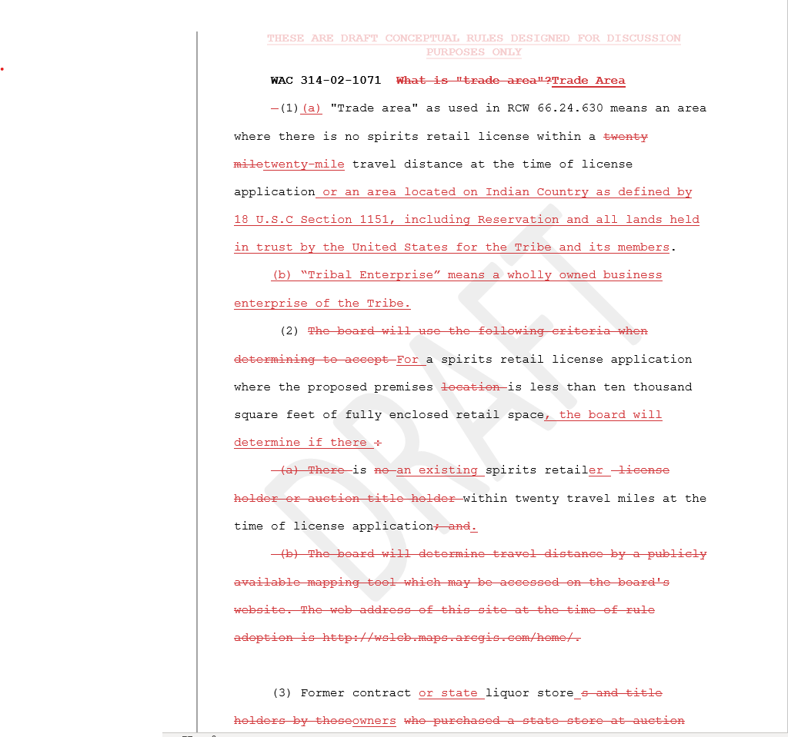
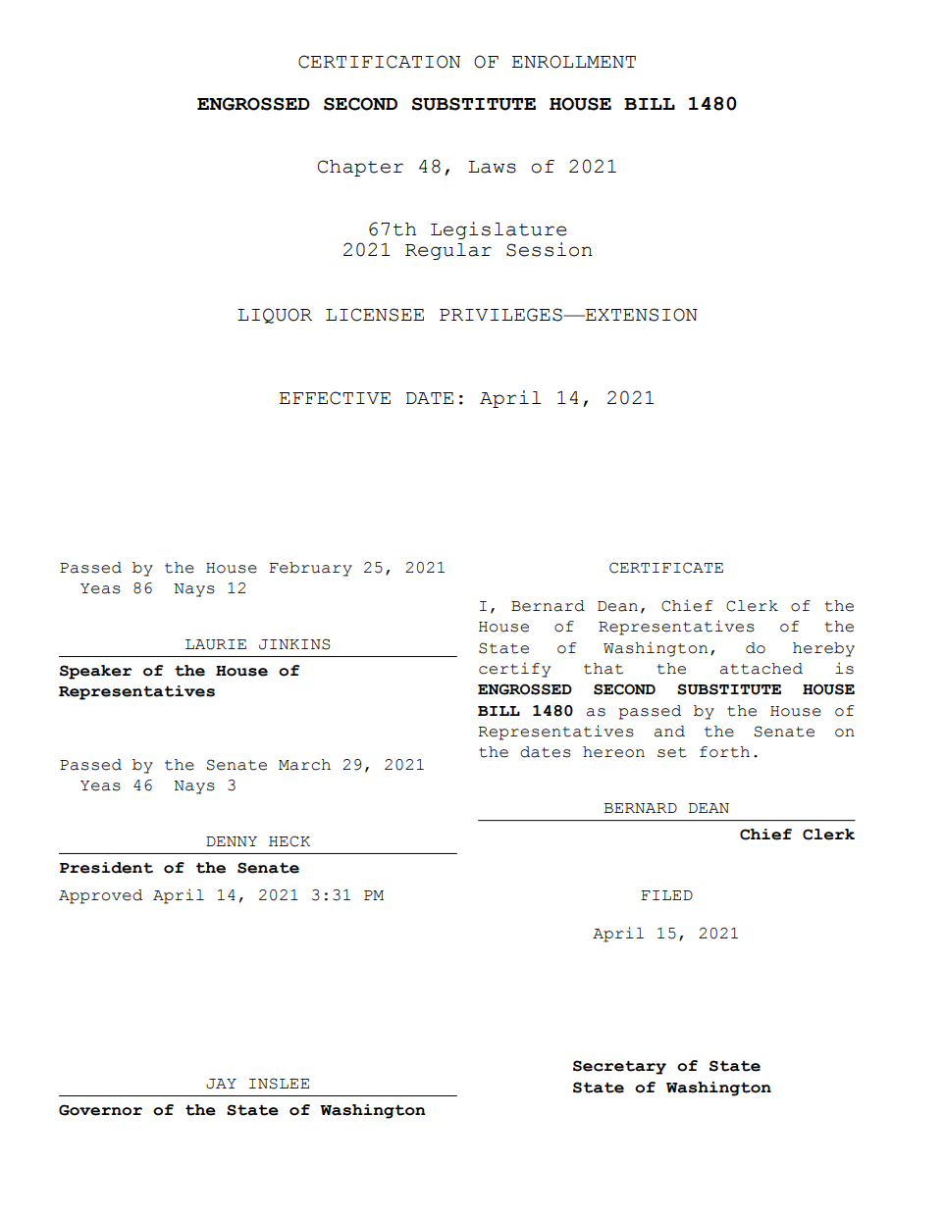
Why are we here?
WAC 314-02-1071 describes how the term “trade area” is determined for purposes of spirits retail license location.
The WSLCB is currently in the CR-101 inquiry phase of the rulemaking process to review WAC 314-02-1071. A Preproposal Statement of Inquiry (CR-101) was filed on May 24, 2023.
Your feedback during today’s workshop will help inform and shape the rules.

Slide 4
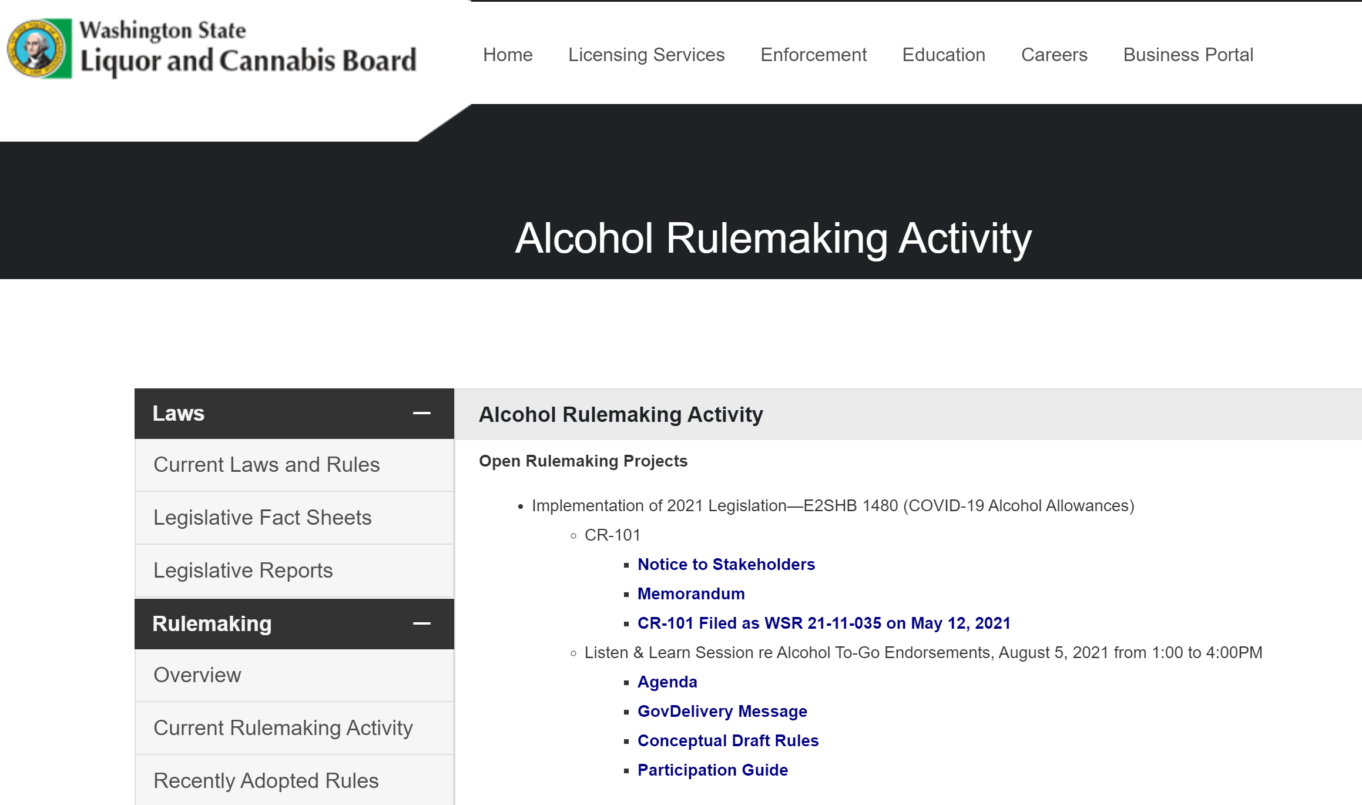
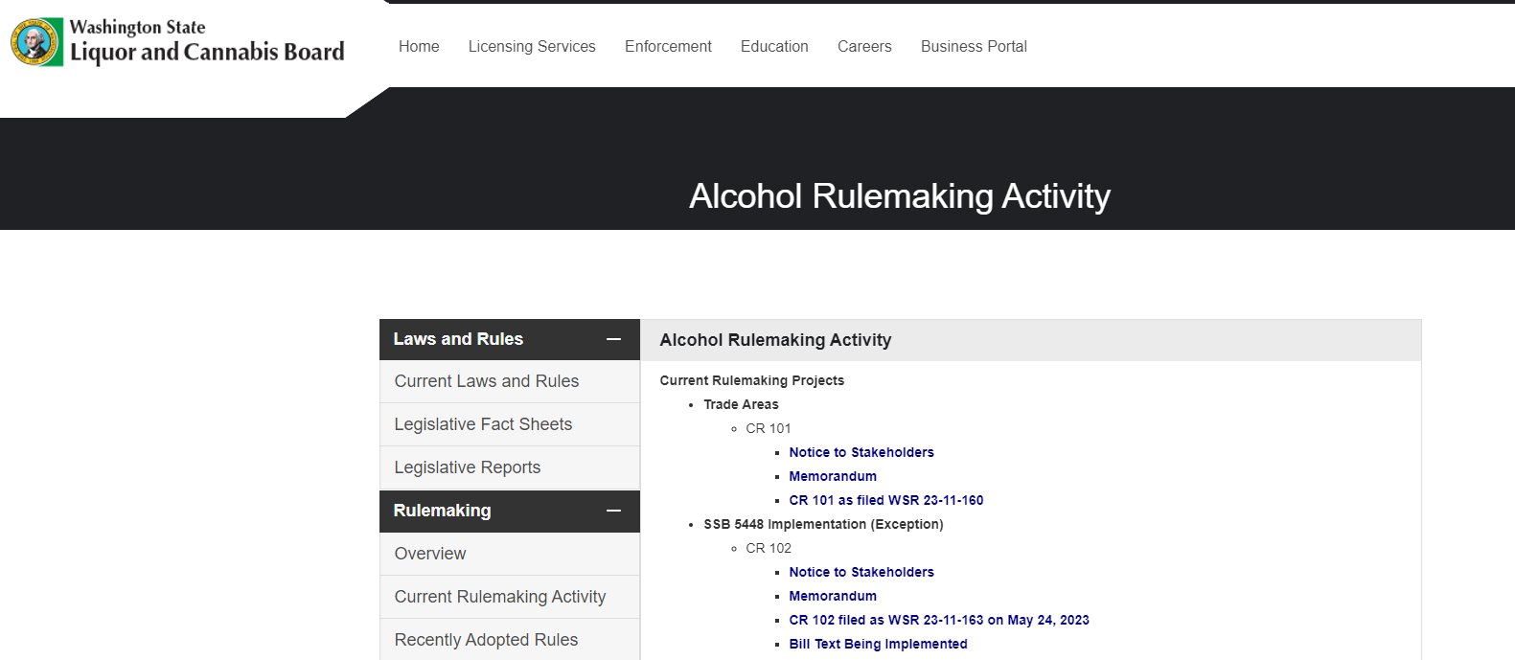
How will data be collected, shared, and presented to decision makers?
The comments and feedback we receive today will be added to a table, organized by theme, and analyzed.
The table will be presented to the Board for review and will be published on the LCB website at a later date.

Slide 5
Meeting Protocol
Participant Roles:
Facilitator
LCB Staff
Participant: In-person or listen only

Slide 6
Meeting Protocol
Participation Expectations
This is a forum to share ideas and solutions, not for debate.
Appreciate the diversity of perspectives.
Please stay on topic. The topic for this forum is conceptual draft rules concerning alcohol trade areas. This is the only topic that will be discussed today. If you have other topics you wish to discuss, please schedule time with WSLCB staff.
Everyone is encouraged to participate with intention.
Maintain a respectful space. Listen to and respect other points of view.
When you speak, please state your name, and where you are from.
Each person attending the in-person sessions will have the opportunity to speak.
The facilitator will read pre-submitted comments for participants who are joining virtually or by phone.
Since this is a public forum, anything shared has the potential to become part of a public record.

Slide 7
Meeting Protocol
Meeting Format
The facilitator will:
Introduce and provide an overview of the conceptual draft rules;
Describe and explain each amendment to existing rule or any new rule sections;
Read any comments that have been submitted in writing before the workshop; and
Invite in-person participants to provide feedback.
When you are called on to provide feedback, please be prepared to speak about:
What you like, don’t like, and offer alternative language for each rule section.

Slide 8
Who is Here?
In-person attendees, please provide:
Your name
Who you are affiliated with or represent (if comfortable sharing)
Why you are interested in this topic

Slide 9
Brief Overview of the Rulemaking Process

Slide 10
Phases of the Rulemaking Process
The Inquiry Phase (CR-101)
Stakeholder Engagement
Rule Development, Drafting, and Analysis
See RCW 34.05.310
The Proposal Phase (CR-102)
Public Hearing/Comments
Agency Responds to Comments
See RCW 34.05.320
The Adoption Phase (CR-103)
Board Votes to Approve Rules
Rules Become Effective
See RCW 34.05.360
There are typically three phases in agency rulemaking: inquiry, proposal, and adoption. (See chapter 34.05 RCW, the Administrative Procedure Act)
The rule development process may take several months to a couple of years to complete, depending on WSLCB resources, complexity of the issue, availability of data or information to complete any required analyses, and public interest in the rule.

Slide 11
Start
CR-101 Pre-proposal Statement of Inquiry
CR-102 Proposal
Stakeholder engagement
Public Hearing/Comments
Rule development, drafting, and analysis
Agency Responds to Comments
CR-103 Final Adoption
Finish

Slide 12
Alcohol Trade Areas – Estimated Rulemaking Timeline
The Inquiry Phase (CR-101)
May 24, 2023 | CR 101 approved by the WSLCB and filed with the Office of the Code Reviser as WSR 23-11-160.
June 07, 2023 | Notice published in the Washington State Register under WSR 23-11.
July 07, 2023 | Initial comment period ended.
July 2023 | Conceptual draft rules are shared publicly through GovDelivery, and Rules Workshops are held to gather public feedback. (Following the Rules Workshops, the WSLCB will review public feedback and consider whether to revise the conceptual draft rules before filing a CR 102 and moving to the rule proposal phase.)
Notes:
The LCB internal workgroup is currently in the process of developing conceptual draft rules. Our goal is to share the conceptual draft rules publicly by early August and hold Listen and Learn sessions designed to engage stakeholders and gather public feedback before moving the rule proposal (CR 102) phase.

Slide 13
The Proposal Phase (CR-102)
August 30, 2023 | WSLCB Staff will ask the Board for approval to file proposed rules (CR 102). If approved, the WSLCB webpage will be updated and notice will be circulated to the rules distribution list through GovDelivery. Formal comment period will begin.
September 6, 2023 | Notice published in the Washington State Register under WSR 23-17.
September 27, 2023 | Public hearing held and formal comment period ends.
The Adoption Phase (CR-103)
October 11, 2023 | WSLCB Staff will ask the Board to adopt final rules (CR 103), if no substantive changes need to be made to the rule proposal. A concise explanatory statement will be provided to individuals offering comment during the formal comment period under RCW 34.05.325. The CR 103 and adopted rules will be filed with the Office of the Code Reviser. The WSLCB webpage will be updated and notice will be circulated to the rules distribution list through GovDelivery.
November 11, 2023 | The rules are effective 31 days after filing unless otherwise specified. See RCW 34.05.380(2).

Slide 14
Review of Conceptual Draft Rules

Slide 15
Feedback

Slide 16
Wrap up
Next steps

Slide 17
Resources
WSLCB Rulemaking Resources
Current Rulemaking Activity: https://lcb.wa.gov/laws/current-rulemaking-activity
Rulemaking Process—Phases: https://lcb.wa.gov/laws/rulemaking-process-phases
Rulemaking FAQs: https://lcb.wa.gov/laws/rulemaking-faqs

Slide 18
Thank you!
Dr. Kathy Hoffman, Research Manager
katherine.hoffman@lcb.wa.gov

