Slide 1
Marijuana Licensing
Recreational Marijuana

Slide 2
Marijuana Retail License and Application Data
LICENSES ISSUED
FY 2015 | 173
FY2016 (As of June 8, 2016) | 205
TOTAL | 378
Notes:
The LCB will not begin to process assumptions or change of locations for retailers until July 2016.

Slide 3
Marijuana Retail Licensing Timelines 502 vs. 5052
Notes:
Numbers are as of 04/08/2016.

Slide 4
Retail Statistics
Only 3% of retail pending and issued applications are to allow 502 applicants within a ban or moratorium area to move jurisdictions.
Notes:
334
222

Slide 5
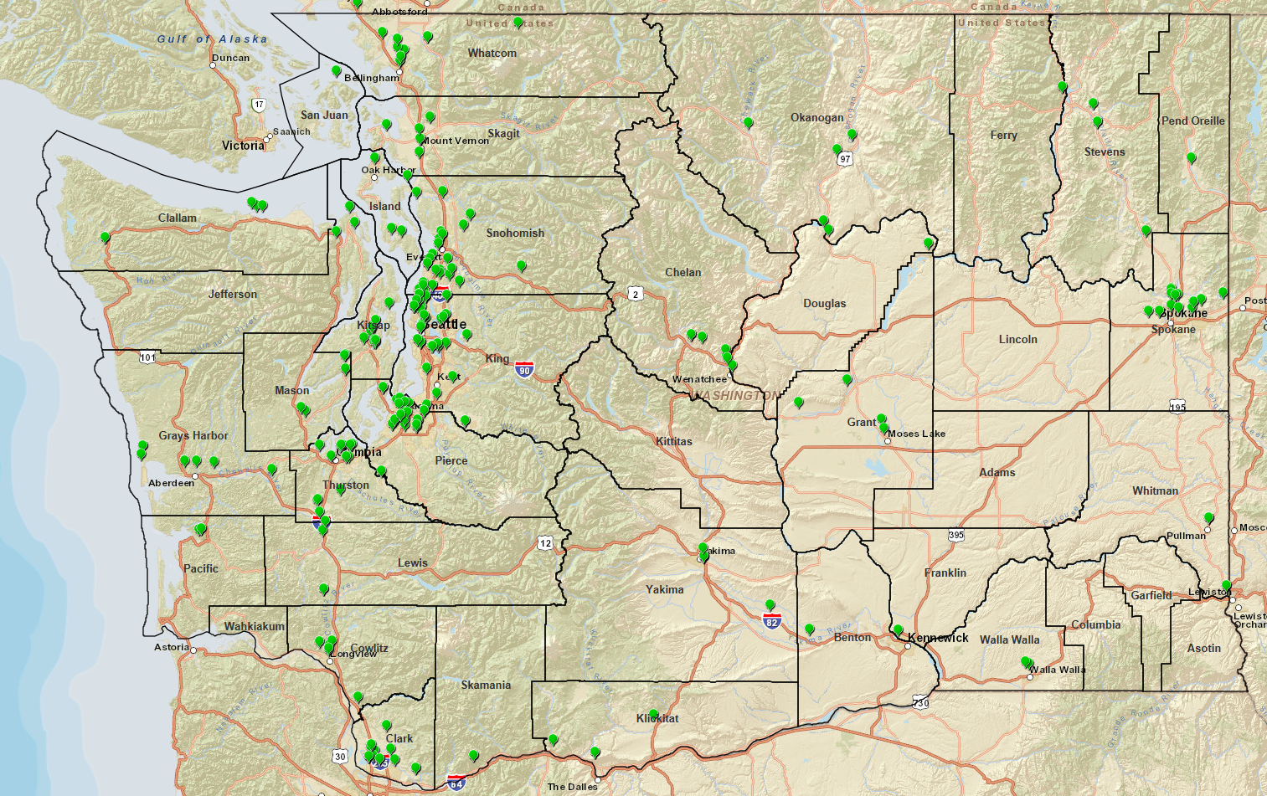
Retail Marijuana Locations

Slide 6
Producer/Processor Statistics
12,952,259 square feet of approved plant canopy
Notes:
The LCB will begin to allow for licensees to assume a 2nd or 3rd non-retail license in the fall of 2016.

Slide 7
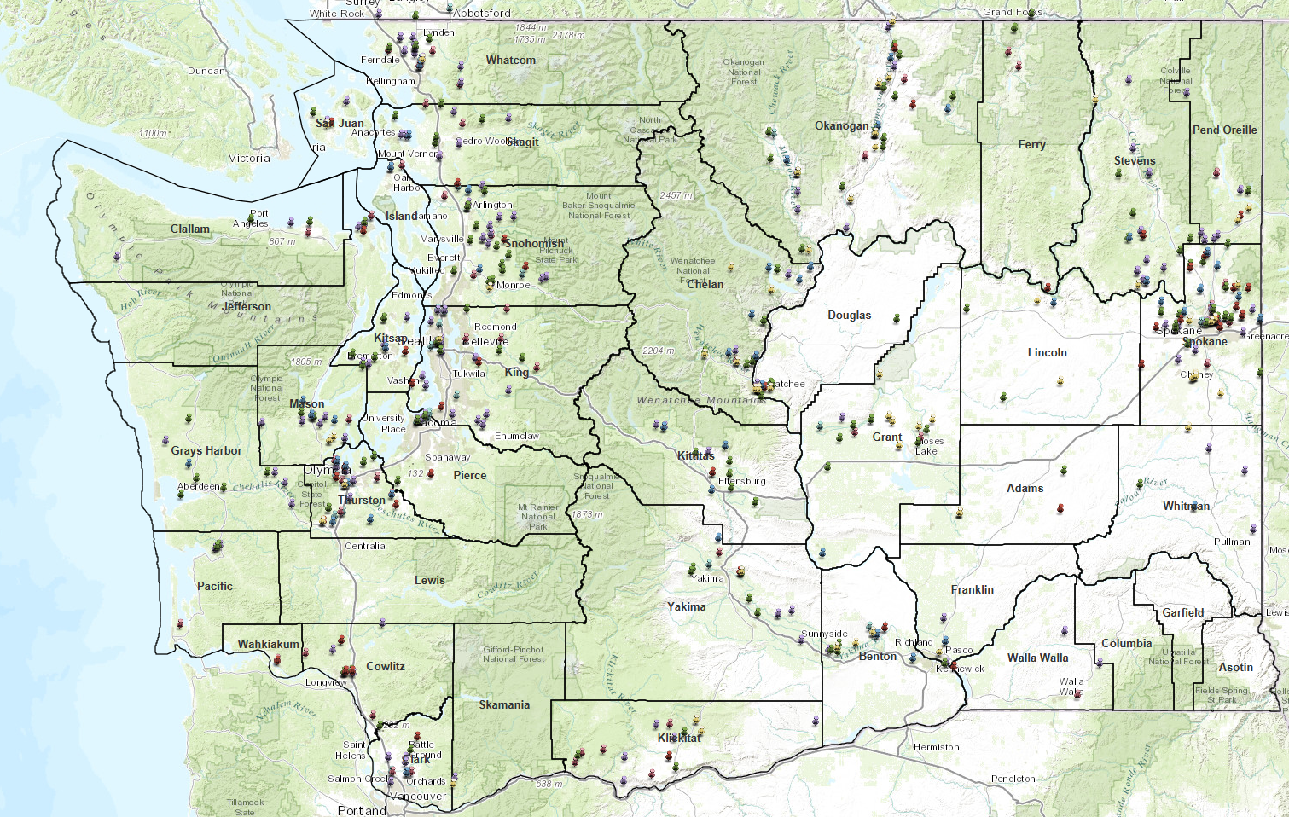
Non-Retail Marijuana Locations (Producers and Processors)

Slide 8
Change Applications

Slide 9
Marijuana Survey Results 2016 Fiscal Year YTD
88% of respondents were either Moderately or Extremely Satisfied.

Slide 10
Additional marijuana licensing data and challenges moving forward
Between October 12, 2015 and March 31, 2016, the LCB received 2,335 5052 retail applications to fill 222 allotments statewide. Including:
338 Priority 1’s (of which 99 were withdrawn and 66 have not been assigned to an investigator)
60 Priority 2’s
1241 Priority 3’s
3 still in priority process
560 applications were withdrawn either due to applicant’s request or because the required documents were not returned.
Customer service has issued 272 Medical Endorsement to licensed retailers.
We have issued 203 plant canopy expansions to allow producers to grow to full capacity. This option is available to all producers.
Renewals are not automatic. Criminal History can be run again and the Local authority has the ability to make comment on the business location and members.
All changes must be approved by the WSLCB prior to the change taking affect.
Challenges:
Local authority zoning requirements, bans and moratoriums make it difficult for applicants to find locations. The WSLCB continues to communicate and work with the local authorities in an effort to alleviate this difficulty.

