Slide 1
Marijuana Licensing
How to become licensed to produce, process or sell recreational marijuana.

Slide 2
Introduction
Purpose – educate applicants on the application process
Questions about the applications process are encouraged
Multiple 10 minute Q & A periods throughout the training – Limit questions to topics covered in that segment
30 minute Q & A session at the end
Mutual Respect
Wait until you are recognized to ask your question
Limit your questions so everyone has a chance
Remember this is not a public forum

Slide 3
What to Expect When Applying for a Marijuana License
This step-by-step license application guide will help you understand the process and let you know what to expect along the way.
Before you apply
Completing the Business License Application
Process for licensing a marijuana business
Expectations for operational plans and financial investigations
Final steps
Question and answer periods

Slide 4
Glossary – Common Terms
Business Licensing Services (BLS): A program of The Washington State Department of Revenue that registers your business with the state and several cities. BLS registers businesses, renews licenses and provides related services for approximately 40,000 businesses monthly.
Customer Service: Friendly team of WSLCB licensing professionals that will be the initial handlers of your marijuana license application.
Licensing Investigators: Small team of WSLCB licensing professionals that will examine your application. They will be your point of contact throughout the marijuana application process.

Slide 5
Glossary – Common Terms
Local Authority (LA): The local government entity that, by law, must be notified of your application. The LA is typically the city mayor, police chief, or county sheriff. The LA has 20 days to respond to any license application. If your license has a LA objection, the WSLCB will suggest that you work with the LA to resolve the issue.
DocuSign: Easy, fast, and secure way to send, sign, track and store documents in the cloud. DocuSign is a computerized system that allows all documents and paperwork to be sent to an applicant, completed and returned to the investigator through email and a secure server.

Slide 6
Choose Your Location
Check with your local authority:
Local requirements
Zoning
Moratoria
Make sure your location is more than 1000 feet* from:
*Measured by the shortest straight line distance from the property line of the licensed premise to the property line of entity above
Location do not need to be finalized to apply:
You do not have to purchase property
You do not need to have a signed lease
You do need the proposed location address to apply
Elementary or secondary school | Playground | Public park
Recreation center or facility | Child care center | Arcade
Public transit center | Library

Slide 7
Choose Your License Type
Producer License (non-retail):
Allows the licensee to produce marijuana for sale at wholesale to marijuana processor licensees and to other marijuana producer licensees
Tier Size:
Tier 1: up to 2000 square feet of plant canopy
Tier 2: 2,001 to 10,000 square feet of plant canopy
Tier 3: 10,001 to 30,000 square feet of plant canopy
Processor License (non-retail):
Allows the licensee to process, package, and label usable marijuana and marijuana-infused products for sale at wholesale to marijuana retailers
Retail License:
Allows the licensee to sell only usable marijuana, marijuana-infused products, and marijuana paraphernalia at retail in retail outlets to persons twenty-one years of age and older

Slide 8
Mandatory Requirements
All applicants must have resided in the State of Washington for at least 3 months prior to application
All applicants are subject to criminal history investigations (fingerprint and criminal history check)
All entities must be formed in the State of Washington - this can be and should be done prior to filing the business application for marijuana
All applicants must be at least 21 years of age
All financiers must meet residency requirement
All financiers are subject to criminal history investigations (fingerprint and criminal history check)

Slide 9
Business License Application
The marijuana license is a specialty license on the Master Business License
In order to apply for a marijuana license you need to apply for a master business license with a marijuana license addendum
Applications will be accepted from November 18 to December 19
Contact Business Licensing Customer Service at 360-705-6744 for help completing the Business License application
Contact Liquor Control Board Customer Service at 360-664-1600 for help completing the Marijuana Addendum
Business Licensing will process your business license application and forward the marijuana license application to the Liquor Control Board for processing

Slide 10
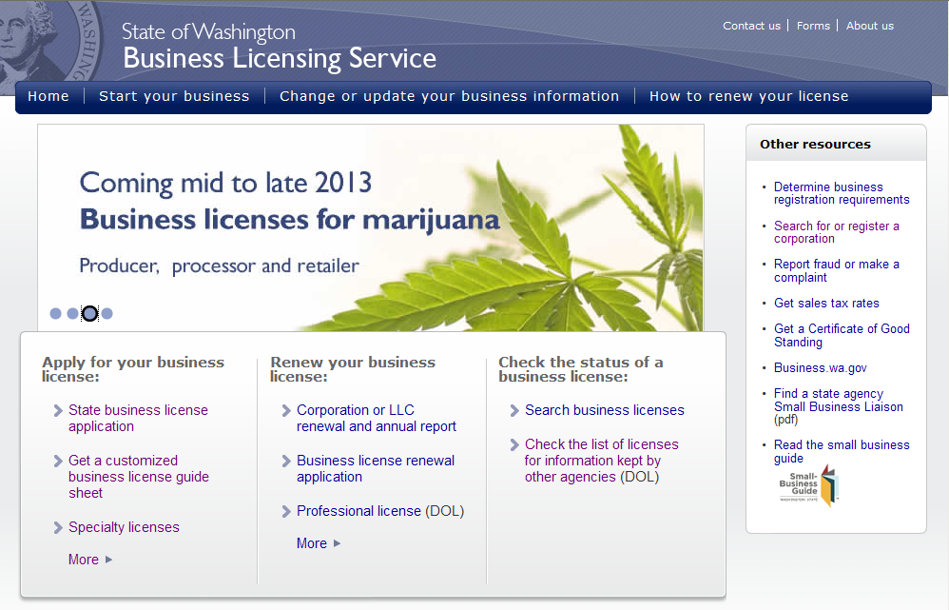
How to Apply for Your Business License
bls.dor.wa.gov

Slide 11
How to Apply for Your Business License
Marijuana Licenses will show in the list here

Slide 12
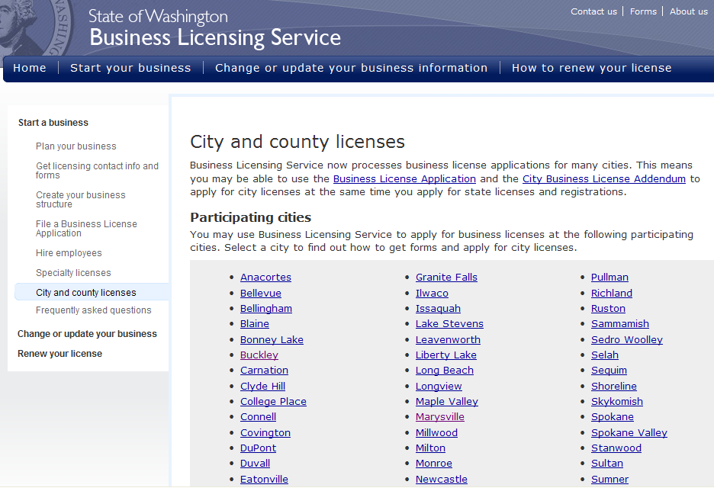
How to Apply for Your Business License

Slide 13
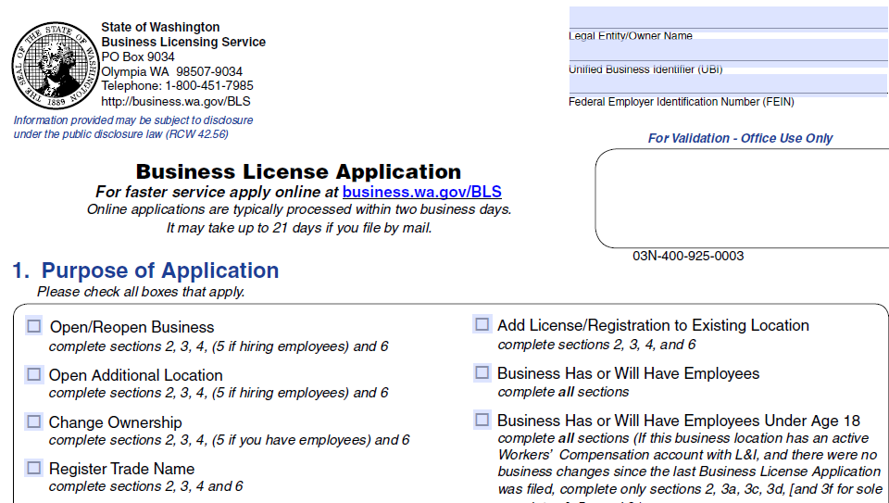
Business License Application

Slide 14
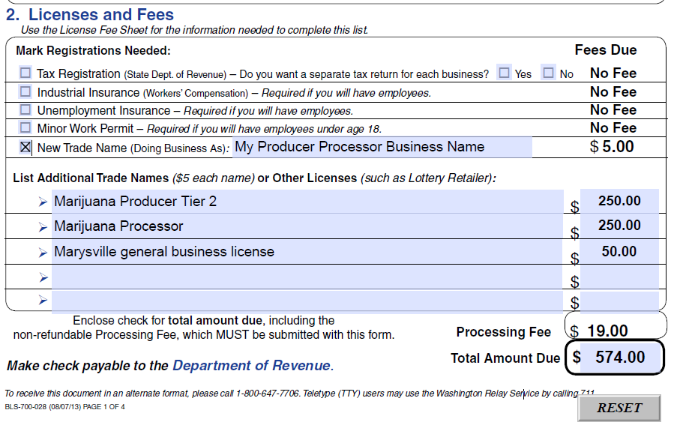
How to Apply for Your Business License

Slide 15
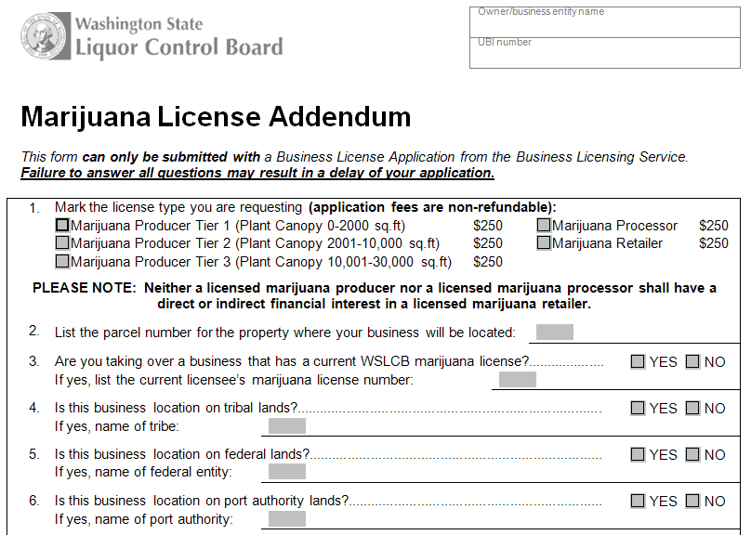
Marijuana License Addendum

Slide 16
Business License Application
Follow instructions on the Marijuana License page on the BLS site
Complete the Business License Application and Marijuana License Addendum
You may either complete the application online, print and mail in the application and addendum or deliver the application and addendum in person to DOR along with necessary fees (DO NOT include the $1000 license fee)
$250 application fee for each application
$19 processing fee & $5 trade name fee with BLS
Additional city/county fees may apply
The various fees will be listed on the BLS Website
Business License Application fees are non-refundable

Slide 17
Business License Application
Submit a separate application for each location
No more than 3 applications per person or entity per type
Retailers with multiple locations are limited to no more than 33% of the allowed licensees in any city or county
An individual or entity cannot apply for both retail and non-retail license types
You can apply for a producer and processor license at the same location
List both license types on the same application
Submit the $250 application fee for each license ($500 total)

Slide 18
Questions?
10 minutes available for questions related to the Business License application process

Slide 19
Application Received by WSLCB
WSLCB Customer Service receives the application from BLS
Staff will send you a welcome email with list of next steps
Your application is assigned to a Marijuana Licensing Investigator
The investigator is your point of contact throughout the licensing process
The investigator will contact all applicants within 14 days of assignment of application to schedule a telephone interview
Initial emphasis will be placed on starting the application process for Producers and Processors. This allows time to:
start growing and processing marijuana so product is available to licensed retailers
conduct a retail lottery (if necessary)
In the event retail applications for a given city or county exceed the allotted licenses, all eligible applicants will be entered into a lottery witnessed by an independent third party

Slide 20
Retail Lottery
Lottery system guidelines are in development to ensure a fair licensing procedure to all applicants who qualify
334 retail licenses will be available – a breakdown of locations is available on our website
The number of retail locations was determined using a formula that distributes the number of locations proportionate to the most populous cities within each county. Locations not assigned to a specific city are “at-large”
Some pre-qualifying measures will be taken prior to the lottery, these may include, but are not limited to :
Verification of distance from restricted entities
All applicants 21 years of age
Personal criminal history checks
Residency requirements
Entity formation in WA

Slide 21
Telephone Interview
Your Marijuana Licensing Investigator will contact you to conduct a telephone interview:
This must be completed with a principal of the applicant entity
An authorized representative can participate but cannot speak on your behalf
The interview usually takes between 15 and 30 minutes
The interview provides time for you to ask any questions you may have regarding the licensing process

Slide 22
Telephone Interview (cont’d)
During the interview we will be asking questions pertaining to:
Parties of interest
The license type for which you have applied and your intent
A description of your proposed location
Whether you own, are leasing, or hope to lease the location
Estimated total cost to open

Slide 23
Telephone Interview (cont’d)
Source of funds to cover your estimated costs
Financier information

Slide 24
Following the Interview
Your investigator will notify the Local Authority of your marijuana application and they will have 20 days to:
Approve
Object
Not Respond
Ask for additional time to review
Your licensing investigator will follow-up with you 14 days after your telephone interview to answer any questions and check the status of document completion
If for any reason you determine that your chosen location will not work, we will:
Put your application on hold
Allow you time to find a new location
Start the process again once you have located another property
Retailers that have been chosen for the lottery will be able to move their location within the awarded area

Slide 25
Request for Documents
Your investigator will prepare a Request for Documents letter tailored to your specific application
Your investigator will email you the Request for Documents, which will outline:
All forms to be completed by the applying entity
All forms to be completed by each required individual
All tasks to be completed prior to final review

Slide 26
Request for Documents (cont’d)
Shortly after you receive the request for documents, your investigator will prepare custom electronic envelopes that will be sent to each party of interest involved with your application through DocuSign
Each person will be required to complete this packet online and submit it back to your assigned investigator
We will typically allow 30 days for completion of the DocuSign envelope
Additional time may be provided if needed

Slide 27
Questions?
10 minutes available for questions related to the Initial Interview and Request for Documents

Slide 28
DocuSign
DocuSign is a secure way for you to complete, sign, and submit required forms online:
You can attach electronic copies of requested documents such as a lease agreement, bank statements, etc.
Electronic signatures through DocuSign are legal and binding
Misrepresentation of fact or failure to disclose a material fact to the Board during the application process is reason for denial
Once completed, DocuSign will send all forms and attached documents back to your licensing investigator
All items in your DocuSign envelope must be completed in order to submit your package back to your investigator
Electronic Signatures conform to Secretary of State “Licensed Certificate Authority” (RCW 19.34)

Slide 29
DocuSign (cont’d)
Some examples of items that will be included in your envelope are:
Entity information
Personal Criminal History Statements
Operating plan
Financial documents
Attachment areas for your lease, purchase and sale agreement, bank statements, etc.
Using an electronic form delivery system increases the speed and accuracy of the licensing process

Slide 30
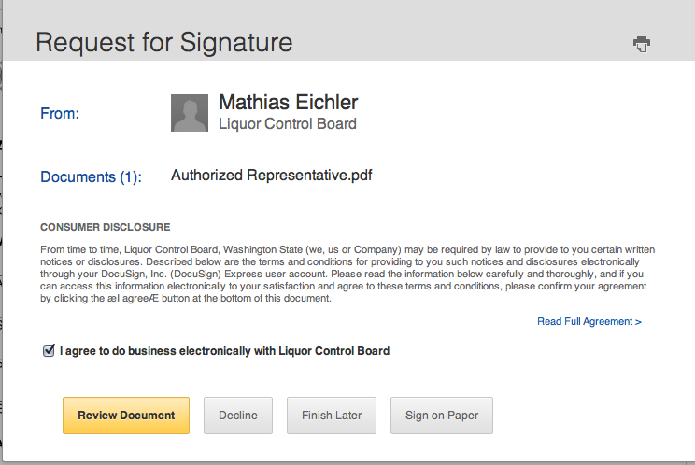
DocuSign (cont’d)
Applicants agree to use an electronic business process.

Slide 31
DocuSign (cont’d)
All application forms have been automated using electronic fields
Simply open the request, follow directions and you will move from entry field to entry field
Time to complete all forms is reduced
Accuracy is improved
You can visit docusign.com for a demo and additional information

Slide 32
DocuSign - Example

Slide 33
Attaching Documents
Attachment sheets are included that allow you to submit requested documents such as:
Lease
Property deeds
Rental Agreements

Slide 34
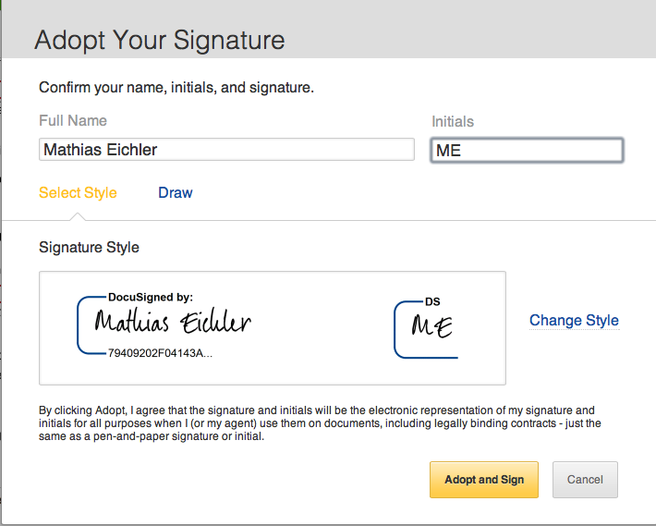
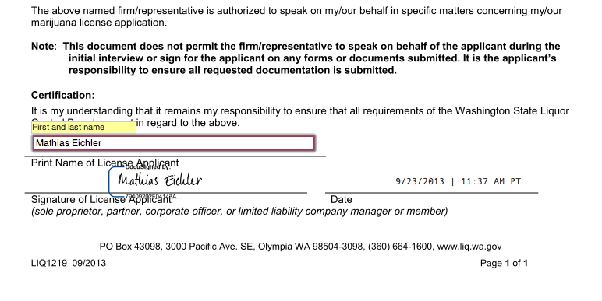
DocuSign – Electronic Signature
Applicants will adopt a legal electronic signature
This signature will be used throughout the electronic business process

Slide 35
Questions?
10 minutes available for questions related to the DocuSign process

Slide 36
Operating Plan
The Operating Plan allows the applicant to demonstrate they are qualified to hold the marijuana license for which they have applied
You will receive an Operating Plan template specific to the license type for which you have applied in your DocuSign envelope

Slide 37
Operating Plan
You will be asked to describe how you plan to comply with requirements listed in WAC
For example:

Slide 38
Operating Plan (cont’d)
Another example:

Slide 39
Traceability System
WSLCB’s traceability system will:
Be web-based
Allow users to upload required information using standardized file formats
Allow users to enter required information into input screens, as an alternative to uploading the information
Some users will utilize a third-party software solution that will link to WSLCB’s system as a means to provide the required information

Slide 40
Questions?
10 minutes available for questions related to the Operating Plan

Slide 41
Financial Investigation Definitions
Financier – any person or entity, other than a banking institution, that has made or will make an investment in the licensed business
A financier is any person or entity that:
Provides money as a gift,
Loans money in expectation of being paid back with or without interest, or
Expects any percentage of the profits from the business in exchange for a loan or expertise
True party of interest – a principal or governing person of a given entity, including, but not limited to:
LLC member/manager, president, vice-president, secretary, treasurer, CEO, director, stockholder, partner, general partner, limited partner
This includes all spouses of all principles or governing persons

Slide 42
Financial Investigation
Financial investigations will be conducted for:
All true parties of interest
Financiers
Persons who exercise control of the business
Financial investigations are necessary to verify all sources of funds needed to start a business:
No minimum or maximum amount required
New businesses are different than established businesses
Examples of documentation commonly requested include, but are not limited to:
Financial forms provided by WSLCB
Bank statements
Tax returns
Financial affidavits

Slide 43
Review of Information Received
Once requested items have been returned:
Your investigator will review all information
Files will be reviewed in order received
Further documentation may be requested
If an objection or request for extension for review has been received from the Local Authority your investigator will:
Provide you a copy of the objection or request
Provide you with options on how to proceed
At this point your investigator will send your file forward for management review along with a report detailing your application information

Slide 44
Final Inspection
Licensing staff will meet with marijuana enforcement staff to discuss your application
You will be given information on contacting your local Enforcement Officer to schedule a final inspection of your premises prior to license issuance
A marijuana enforcement officer will visit your physical location:
All information provided in your submitted operating plan/floor plan will be verified (such as, but not limited to):
Alarm system
Video surveillance and recording device
Security areas
Quarantine area
Perimeter fencing
Point-of-Sale areas
No plant material may be on the premises during time of final inspection

Slide 45
Decision
You will be contacted by your license investigator or a licensing supervisor regarding the status of your application
If approved, you will move on to the final steps
Issuance of a license does not guarantee the ability to operate your business, other state and local laws may apply
WSLCB may issue a license over an LA objection
If the WSLCB seeks denial, you will be given options to appeal or withdraw your application.

Slide 46
License Fee
If approved, you will receive a billing statement through DocuSign
We accept check, cashiers check, or cash (no credit cards accepted)
Fees will be prorated so your marijuana license expiration date matches your business license expiration date
If we issue your license in April and your entity expires in August we would bill you for four month of use or $333.33 (4/12th of $1000)
It is important you submit payment by the due date listed as the prorated amount will change after the due date indicated

Slide 47
Final Steps
Once the fees are received and processed, customer service will email you an approval letter
Business Licensing Services is notified when your license is approved in our system
Within 14 days of receiving your letter, Business Licensing Services will mail you a hard copy of your Master Business License that will show your marijuana license in the body
After producers have notified WSLCB of their intent to start operations they will have a 15-day window to bring non-flowering plants into their location
All plants must be entered into the traceability system during this 15-day period
Moving forward, each year you will receive your renewal notice directly from BLS

Slide 48
Questions?
Any final questions?

Slide 49
Thank You
Visit the WSLCB website at: www.liq.wa.gov for additional information.

